Slide 1
Kako uskočiti u EOSC vlak
ili
Što znači biti EOSC kompatibilan
(How to jump into the EOSC train
or
What does it mean to be EOSC-compatible)
National Capacity Building NI4OS Europe Training, PUBMET2020
dr.sc. Tomislav Lipić
dr.sc. Davor Davidović

Slide 2
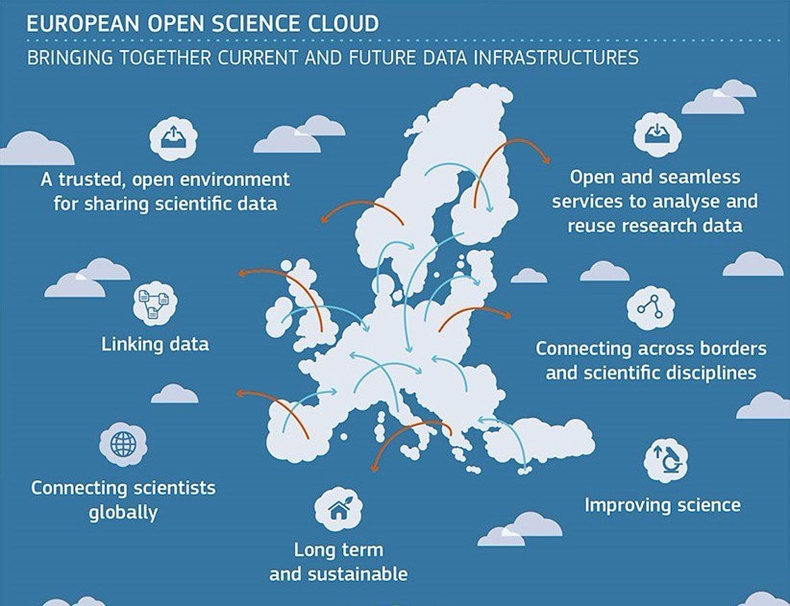
The European Open Science Cloud (EOSC)
Notes:
„The European Open Science Cloud (EOSC) je vizija federativne, globalno dostupne, multi-disciplinarne okoline u kojoj istraživači, inovatori, kompanije i građani mogu međusobno publicirati, pretraživati i koristiti podatke, alate i druge rezultate za svoja straživanja, inovacije i edukaciju.”

Slide 3
EOSC projects
RBI - infrastructure projects
2015
2016
2017
2018
2019
2020
2021
2022
Other EOSC projects
Thematic projects
Notes:
„The European Open Science Cloud (EOSC) je vizija federativne, globalno dostupne, multi-disciplinarne okoline u kojoj istraživači, inovatori, kompanije i građani mogu međusobno publicirati, pretraživati i koristiti podatke, alate i druge rezultate za svoja straživanja, inovacije i edukaciju.”

Slide 4
EOSC-Hub
Main objectives:
Simplify access to a broad portfolio of products, resources and services provided by pan-European organisations through an open and integrated service catalogue
Remove fragmentation of service provisioning and access to high-quality digital services through the technical integration and adoption of standards for interoperability of compute, storage, data and software platforms
Consolidate e-Infrastructures by expanding capacity and capabilities and improving service quality
Widen the access to services to researchers, high-education, business organisations and expand the user base
01/2018 - 12/2020
100 partners from 53 countries
RBI role includes integration and adaptation of computing services for digital humanities (DH) needs
Notes:
mastodontski projekt

Slide 5
NI4OS: National Initiatives for Open Science in Europe
Main objectives:
Facilitate the federation of existing infrastructures & SoA services and their smooth on-boarding into EOSC - focus on OSC initiatives from 15 members of project consortium (SE-Europa)
Enable the EOSC-relevant, non-commercial infrastructures, repositories and thematic services to be accessed through the EOSC portal.
Provide the necessary technical, organizational and legal guidelines, tools, mechanisms and certification schemes, to support Open Research Data Management (ORDM) and its implementation in a harmonized and coordinated fashion.
01/2018 - 12/2020
22 partners from 15 countries
RBI role includes 'onboarding' of specific thematic services (bioinformatics) from RBI research groups.
Notes:
Build national Open Science Cloud (OSC) initiatives for open research data, infrastructure and services and enable them to support the overall EOSC governance and coordination structure

Slide 6
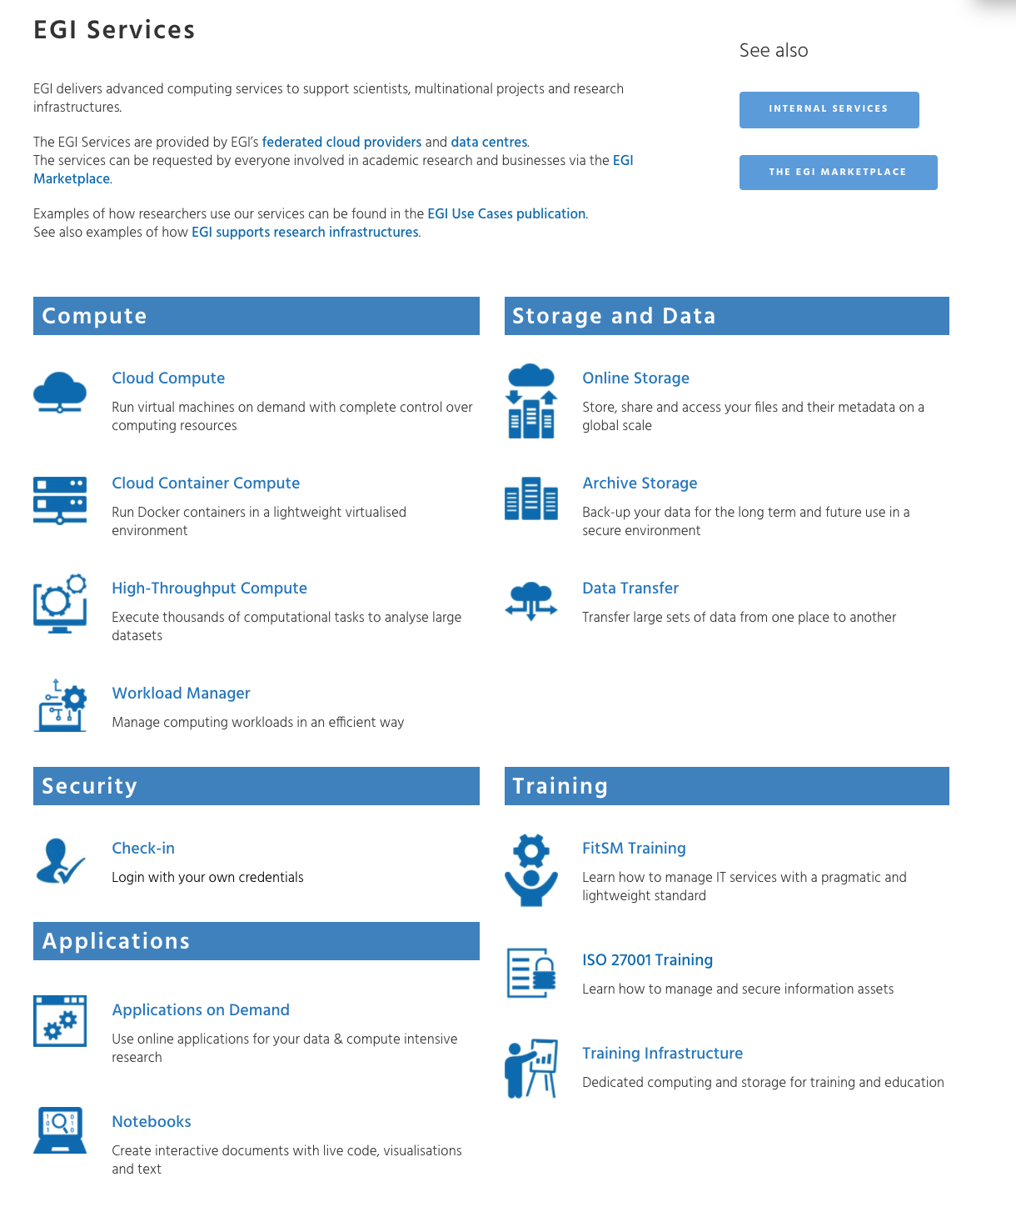
EOSC portal services vs EGI services
https://eosc-hub.eu/services
https://www.egi.eu/services/
Notes:
https://eosc-hub.eu/service-provider-form

Slide 7
On-boarding in general:
Onboarding includes all practical activities taken to incorporate a research resources into the EOSC federation
In general, NI4OS resource onboarding includes five main steps:
a request via a dedicated from - project operational team will initiate the onboarding procedure for all resources and send the corresponding request to the EOSC,
relevant information is gathered using a portal-specific RDT,
a resource is integrated with the NI4OS pre-production environment,
a service is validated by tools from the NI4OS pre-production environment,
a service is published in the EOSC catalogue
Notes:
On-boarding of a resource (service or repository) into the EOSC includes all practical activities taken to incorporate a research resource into the EOSC federation.
In general, resource on-boarding includes five main steps illustrated in Figure 1:
a request is sent by the service provider via e-mail or submitted via a dedicated form that officially initiates the on-boarding process;
relevant information is gathered using a service description template or a corresponding online form, which could be incorporated in the service catalogue/portfolio system;
the resource is integrated with the existing EOSC tools and federated core, such that it is compatible with the defined rules of participation;
the resource is validated using tools from the federated core;
the resource is published in the EOSC catalogue.

Slide 8
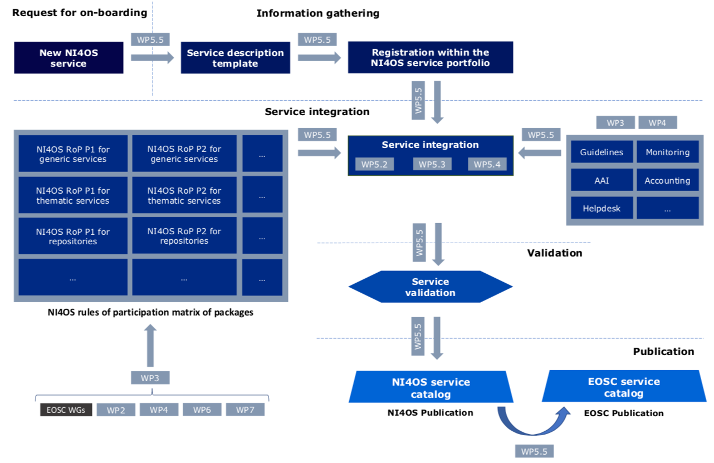
NI4OS-Europe view of the on-boarding process
https://eosc-hub.eu/service-provider-form
https://www.openaire.eu/category/content-providers
Notes:
The procedure is supported by the necessary templates and documents as well as the preproduction framework used to validate these services and their integration.
Once NI4OS-Europe verifies the service or repository, it will be published within the project catalogue, and the WP5 team will proceed with its EOSC registration. This should go smoothly since our procedures and rules will be compatible with the EOSC ones.
For service registration, we will use the EOSC portal Join as a provider form [9], while for repositories, we will use the Open AIRE content provider dashboard [11].
Join as provider form, https://eosc-hub.eu/service-provider-form
OpenAIRE content providers, https://www.openaire.eu/category/content-providers
On-boarding of a resource (service or repository) into the EOSC includes all practical activities taken to incorporate a research resource into the EOSC federation.
In general, resource on-boarding includes five main steps illustrated in Figure 1:
a request is sent by the service provider via e-mail or submitted via a dedicated form that officially initiates the on-boarding process;
relevant information is gathered using a service description template or a corresponding online form, which could be incorporated in the service catalogue/portfolio system;
the resource is integrated with the existing EOSC tools and federated core, such that it is compatible with the defined rules of participation;
the resource is validated using tools from the federated core;
the resource is published in the EOSC catalogue.

Slide 9
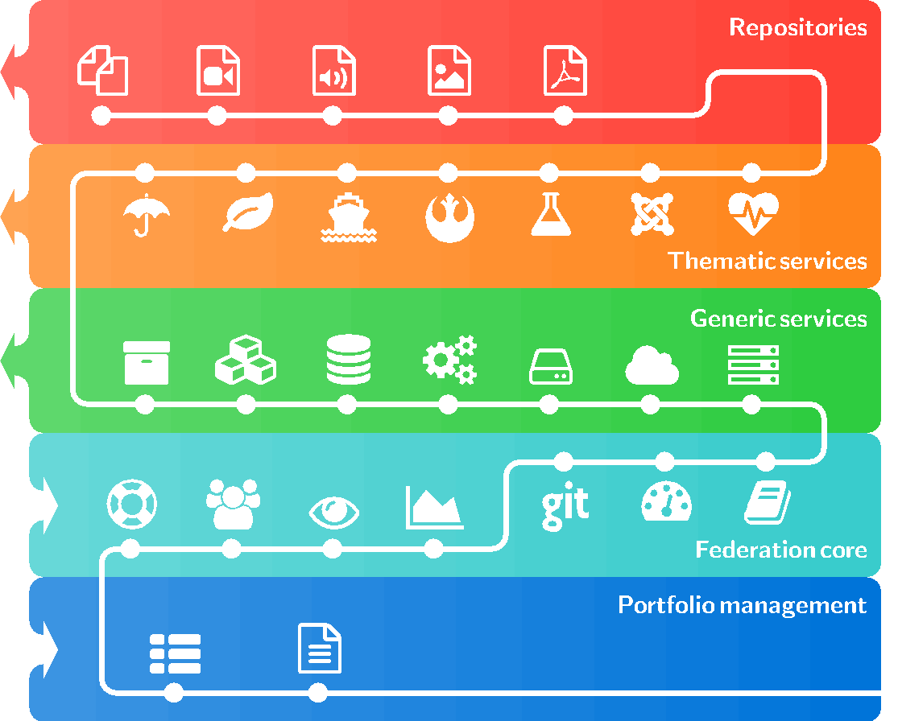
On-boarding of different service types
Notes:
During the proposal stage of the NI4OS-Europe project, we have organized regional services in a hierarchical structure, based on their functions and relationships:
pre-production environment service;
At the first level of this hierarchy, we have grouped the pre-production environment services that provide the functionality of the federation and access-enabling or Federated core services, such as monitoring, helpdesk, AAI, accounting, etc. These allow unique access to all other services and create a unique metric for the measurement of service performance in terms of utilization, provided support, availability, and reliability
generic services;
Common services provide generic capabilities and address technical needs that are common to various research areas, so that they can be used by multiple thematic services. The services from this level of the hierarchy, support different aspects of the data lifecycle, from creation to processing, analysis, preservation, access, and reuse. Typically, here we have generic HTC/HPC computing, Platform-as-a-Service (PaaS) solutions, generic storage, data preservation/curation/provenance, cloud containerization and orchestration resources, etc., as well as advanced services for data discovery, management, processing, workflow management, etc.
thematic services;
thematic services are research community-specific services that provide value to the researchers. In this category, we have grouped highly cross-disciplinary services that typically provide access to the community-specific data resources through the software layer that unifies tools for various analyses, comparison, visualization, study, and all other numerous aspects of post-processing. Besides the integration with the Federation and access-enabling services, the thematic services usually depend on the generic services, whose integration will be realized within the framework of the project.
repositories
At the highest level of the hierarchy, we have grouped various literature and data repositories that hold and preserve scientific information. In contrast to the generic and common services, which will be directly on-boarded to the EOSC, the repositories will be on-boarded using the OpenAIRE platform. Thus, during the on-boarding process, we have to ensure compliance with the OpenAIRE policies, while the OpenAIRE team will perform integration of their complete platform to the EOSC.
Figure 3 also includes the portfolio management level (as the lowest level) to illustrate different options for integration that could be achieved within the EOSC. Starting from the lowest level, all types of services have to be described consistently by a portfolio management schema, which is described in Section 3.3, and usually incorporated into the Service catalogue/portfolio system.
NI4OS-Europe onboarding includes:
Pre-production environment to prepare for the onboarding process (validating readiness and maturity level)
Inclusion in the service and portfolio management system / service description template
Integration with the federation core services (AAI, monitoring, accounting, etc.)
Integration with generic services (HPC, HTC, cloud, storage, etc.)
Usage of the thematic services
Inclusion of repositories (data, publication, code)

Slide 10
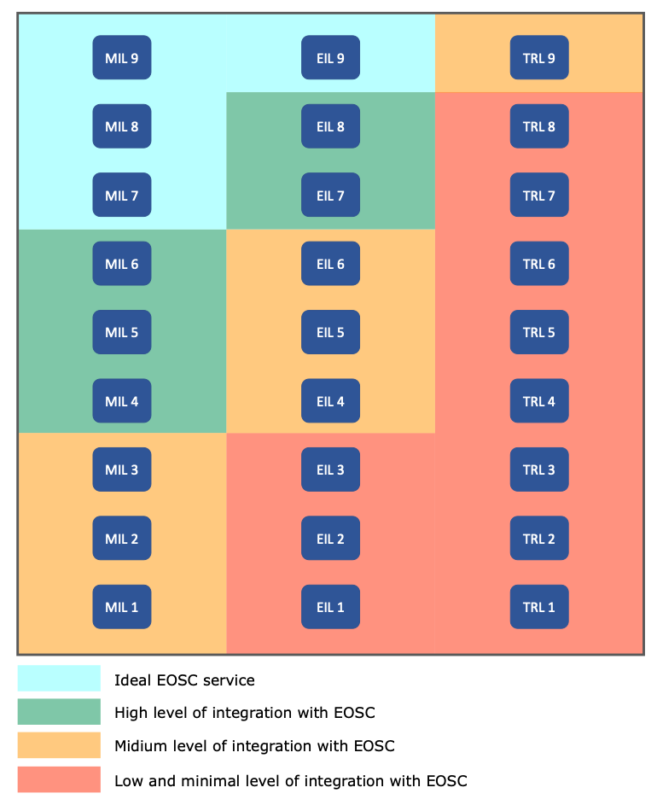
Levels of integration
NI4OS-Europe uses multiple categorization of services:
Technology Readiness Levels (TRL)
EOSC Integration Levels (EIL)
Management Integration Levels (MIL)
All three categorizations used to assess EOSC readiness of each of the services to be onboarded.
Notes:
MIL1 - MIL9
Service Portfolio Management - Information Security management - Incident and Service Request Management - Order and Customer relationship management - service availability and continuity management / service level management - Release and Deployment management/Configuration Management - Continual Service Management/Change management
EIL 1 - EIL9
Basic Service Description - Terms of Use/User manual - Helpdesk/Privacy Policy - AAI/PID for service/Code repository - Monitoring/Generic service integration - Accounting/training resources/Datasets production - Service Management/API production - Workflow production
zanimljivo je za EIL da su to npr. integracija s accounting-om, EOSC/NI4OS helpdeskom, uključenost u training platformu, produkcijski API, itd...

Slide 11
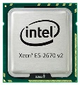
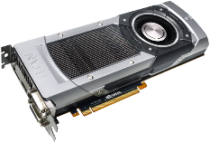
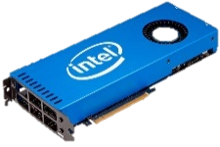
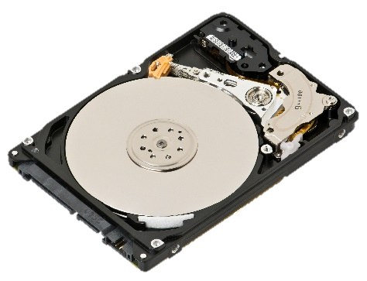
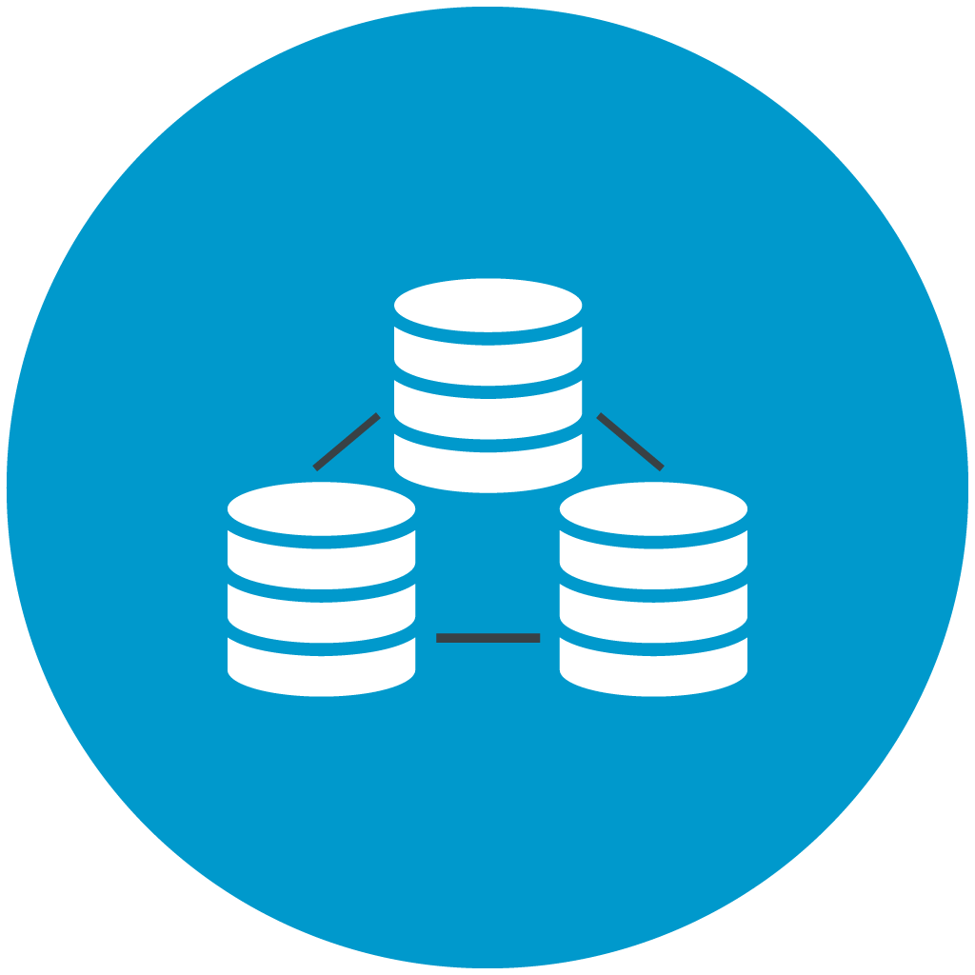
EOSC candidate generic services
HPC Resources
CPU
GPU
Xeon Phi
Cloud Virtual Machines
Generic Storage
Data management services (Archival, Repository, Data discovery, Hadoop on-demand, Data analysis service, Simple storage)

Slide 12
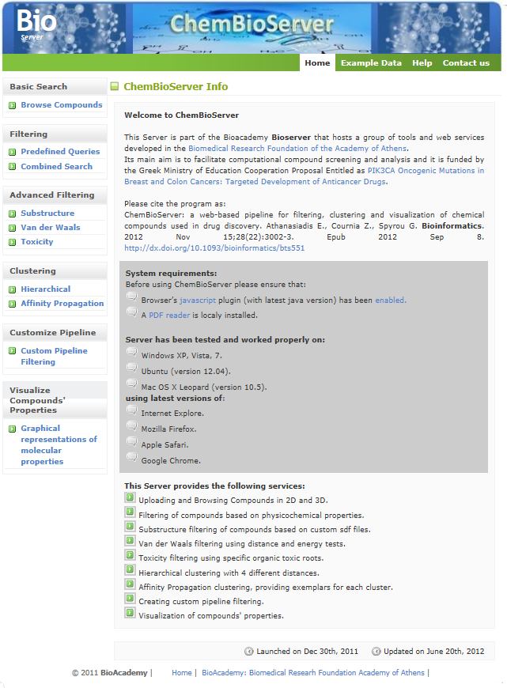
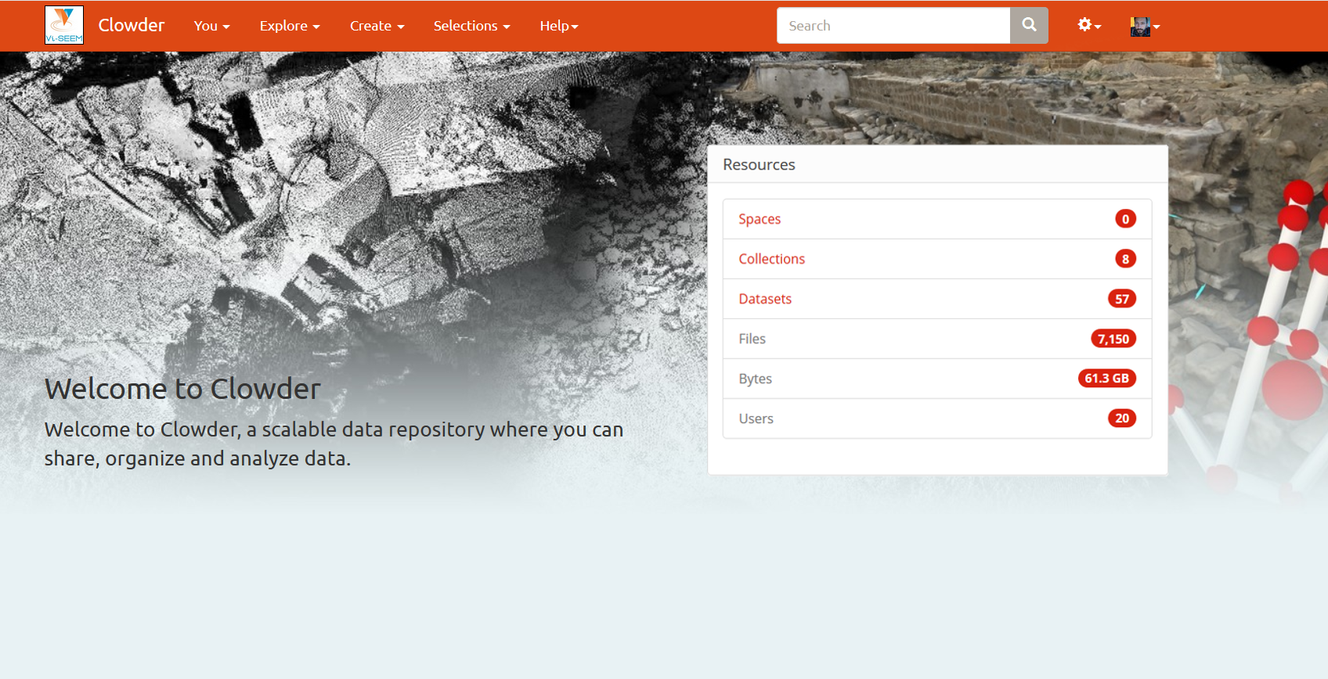
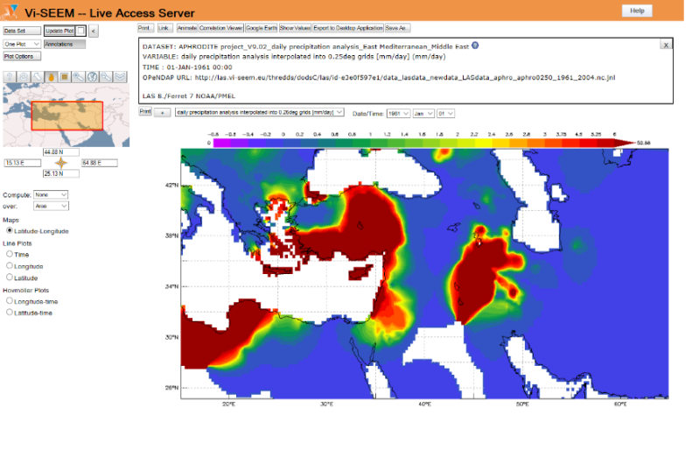
EOSC candidate thematic services: examples
ChemBioServer
Service for filtering, clustering and visualization of chemical compounds used in drug discovery
DCH Clowder
A Digital Culture Heritage repository which also offers integrated interactive visualization tools
Live Access Server
A web server providing flexible access to geo-referenced scientific data, offering visualization & post-processing capabilities for climate data

Slide 13
An example of thematic service
http://revigo.irb.hr/
Notes:
REVIGO is a Web server that summarizes long, unintelligible lists of GO terms by finding a representative subset of the terms using a simple clustering algorithm that relies on semantic similarity measures. Furthermore, REVIGO visualizes this non-redundant GO term set in multiple ways to assist in interpretation: multidimensional scaling and graph-based visualizations accurately render the subdivisions and the semantic relationships in the data, while treemaps and tag clouds are also offered as alternative views. REVIGO is freely available at http://revigo.irb.hr/.
The NI4OS-Europe specific on-boarding procedure is described in this document to help the service providers integrate their services in EOSC. The procedure is supported by the necessary templates and documents as well as the preproduction framework used to validate these services and their integration.

Slide 14
Example of thematic service:
REVIGO - REduction and VIsualization of Gene Ontology
What is the secret behind its success?
Functionality + Accessibility + Availability
Notes:
REVIGO is a Web server that summarizes long, unintelligible lists of GO terms by finding a representative subset of the terms using a simple clustering algorithm that relies on semantic similarity measures. Furthermore, REVIGO visualizes this non-redundant GO term set in multiple ways to assist in interpretation: multidimensional scaling and graph-based visualizations accurately render the subdivisions and the semantic relationships in the data, while treemaps and tag clouds are also offered as alternative views. REVIGO is freely available at http://revigo.irb.hr/.
The NI4OS-Europe specific on-boarding procedure is described in this document to help the service providers integrate their services in EOSC. The procedure is supported by the necessary templates and documents as well as the preproduction framework used to validate these services and their integration.

Slide 15
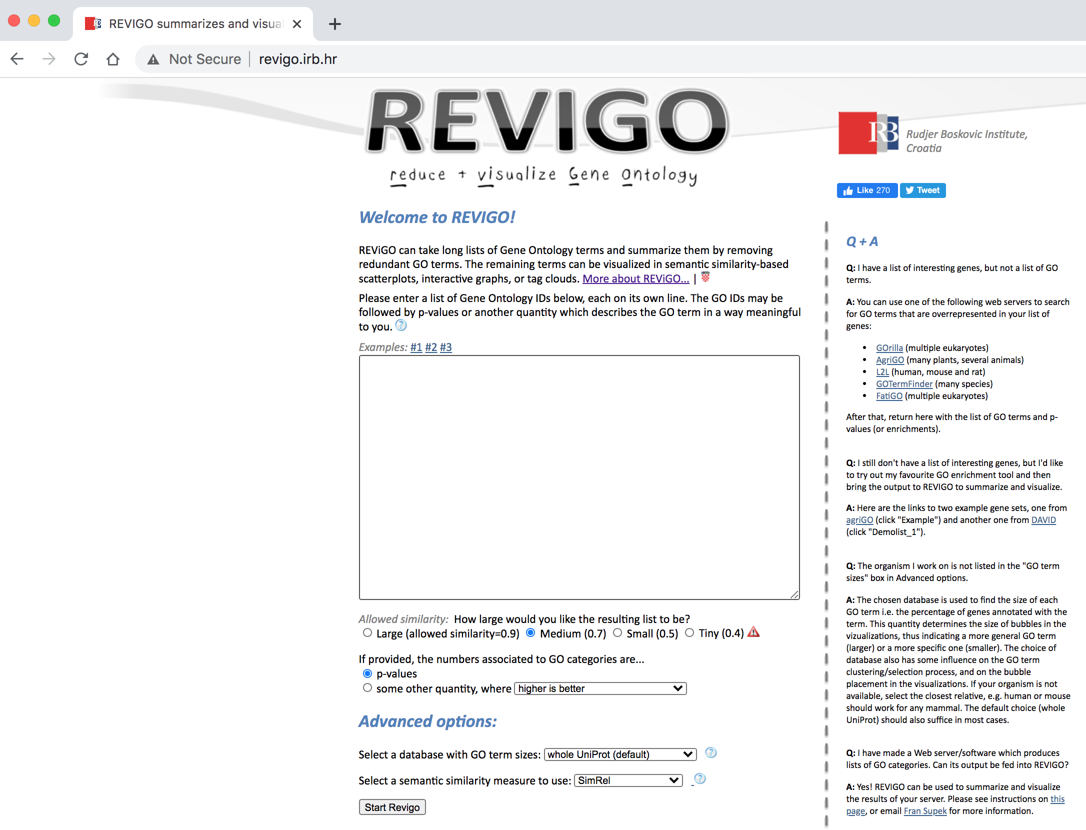
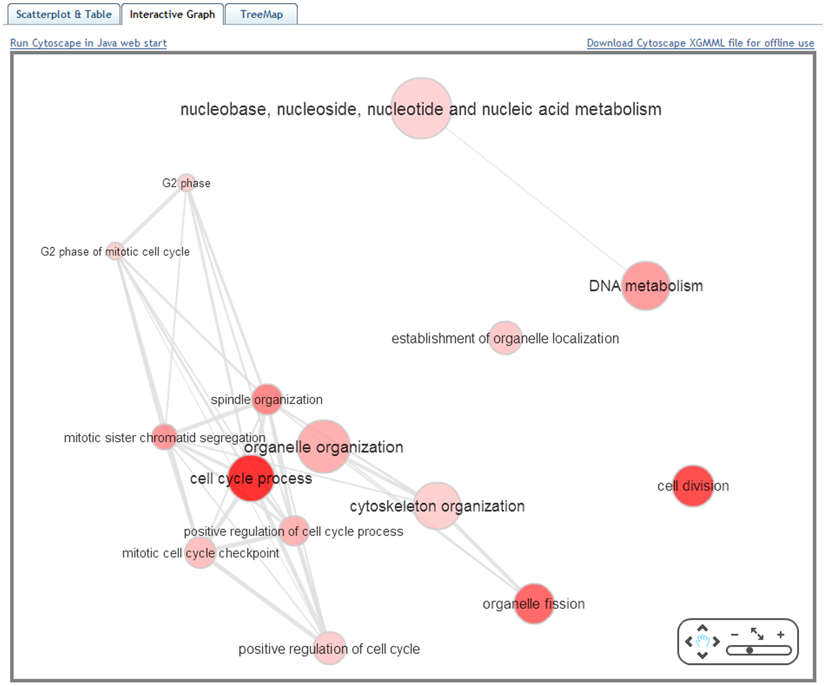
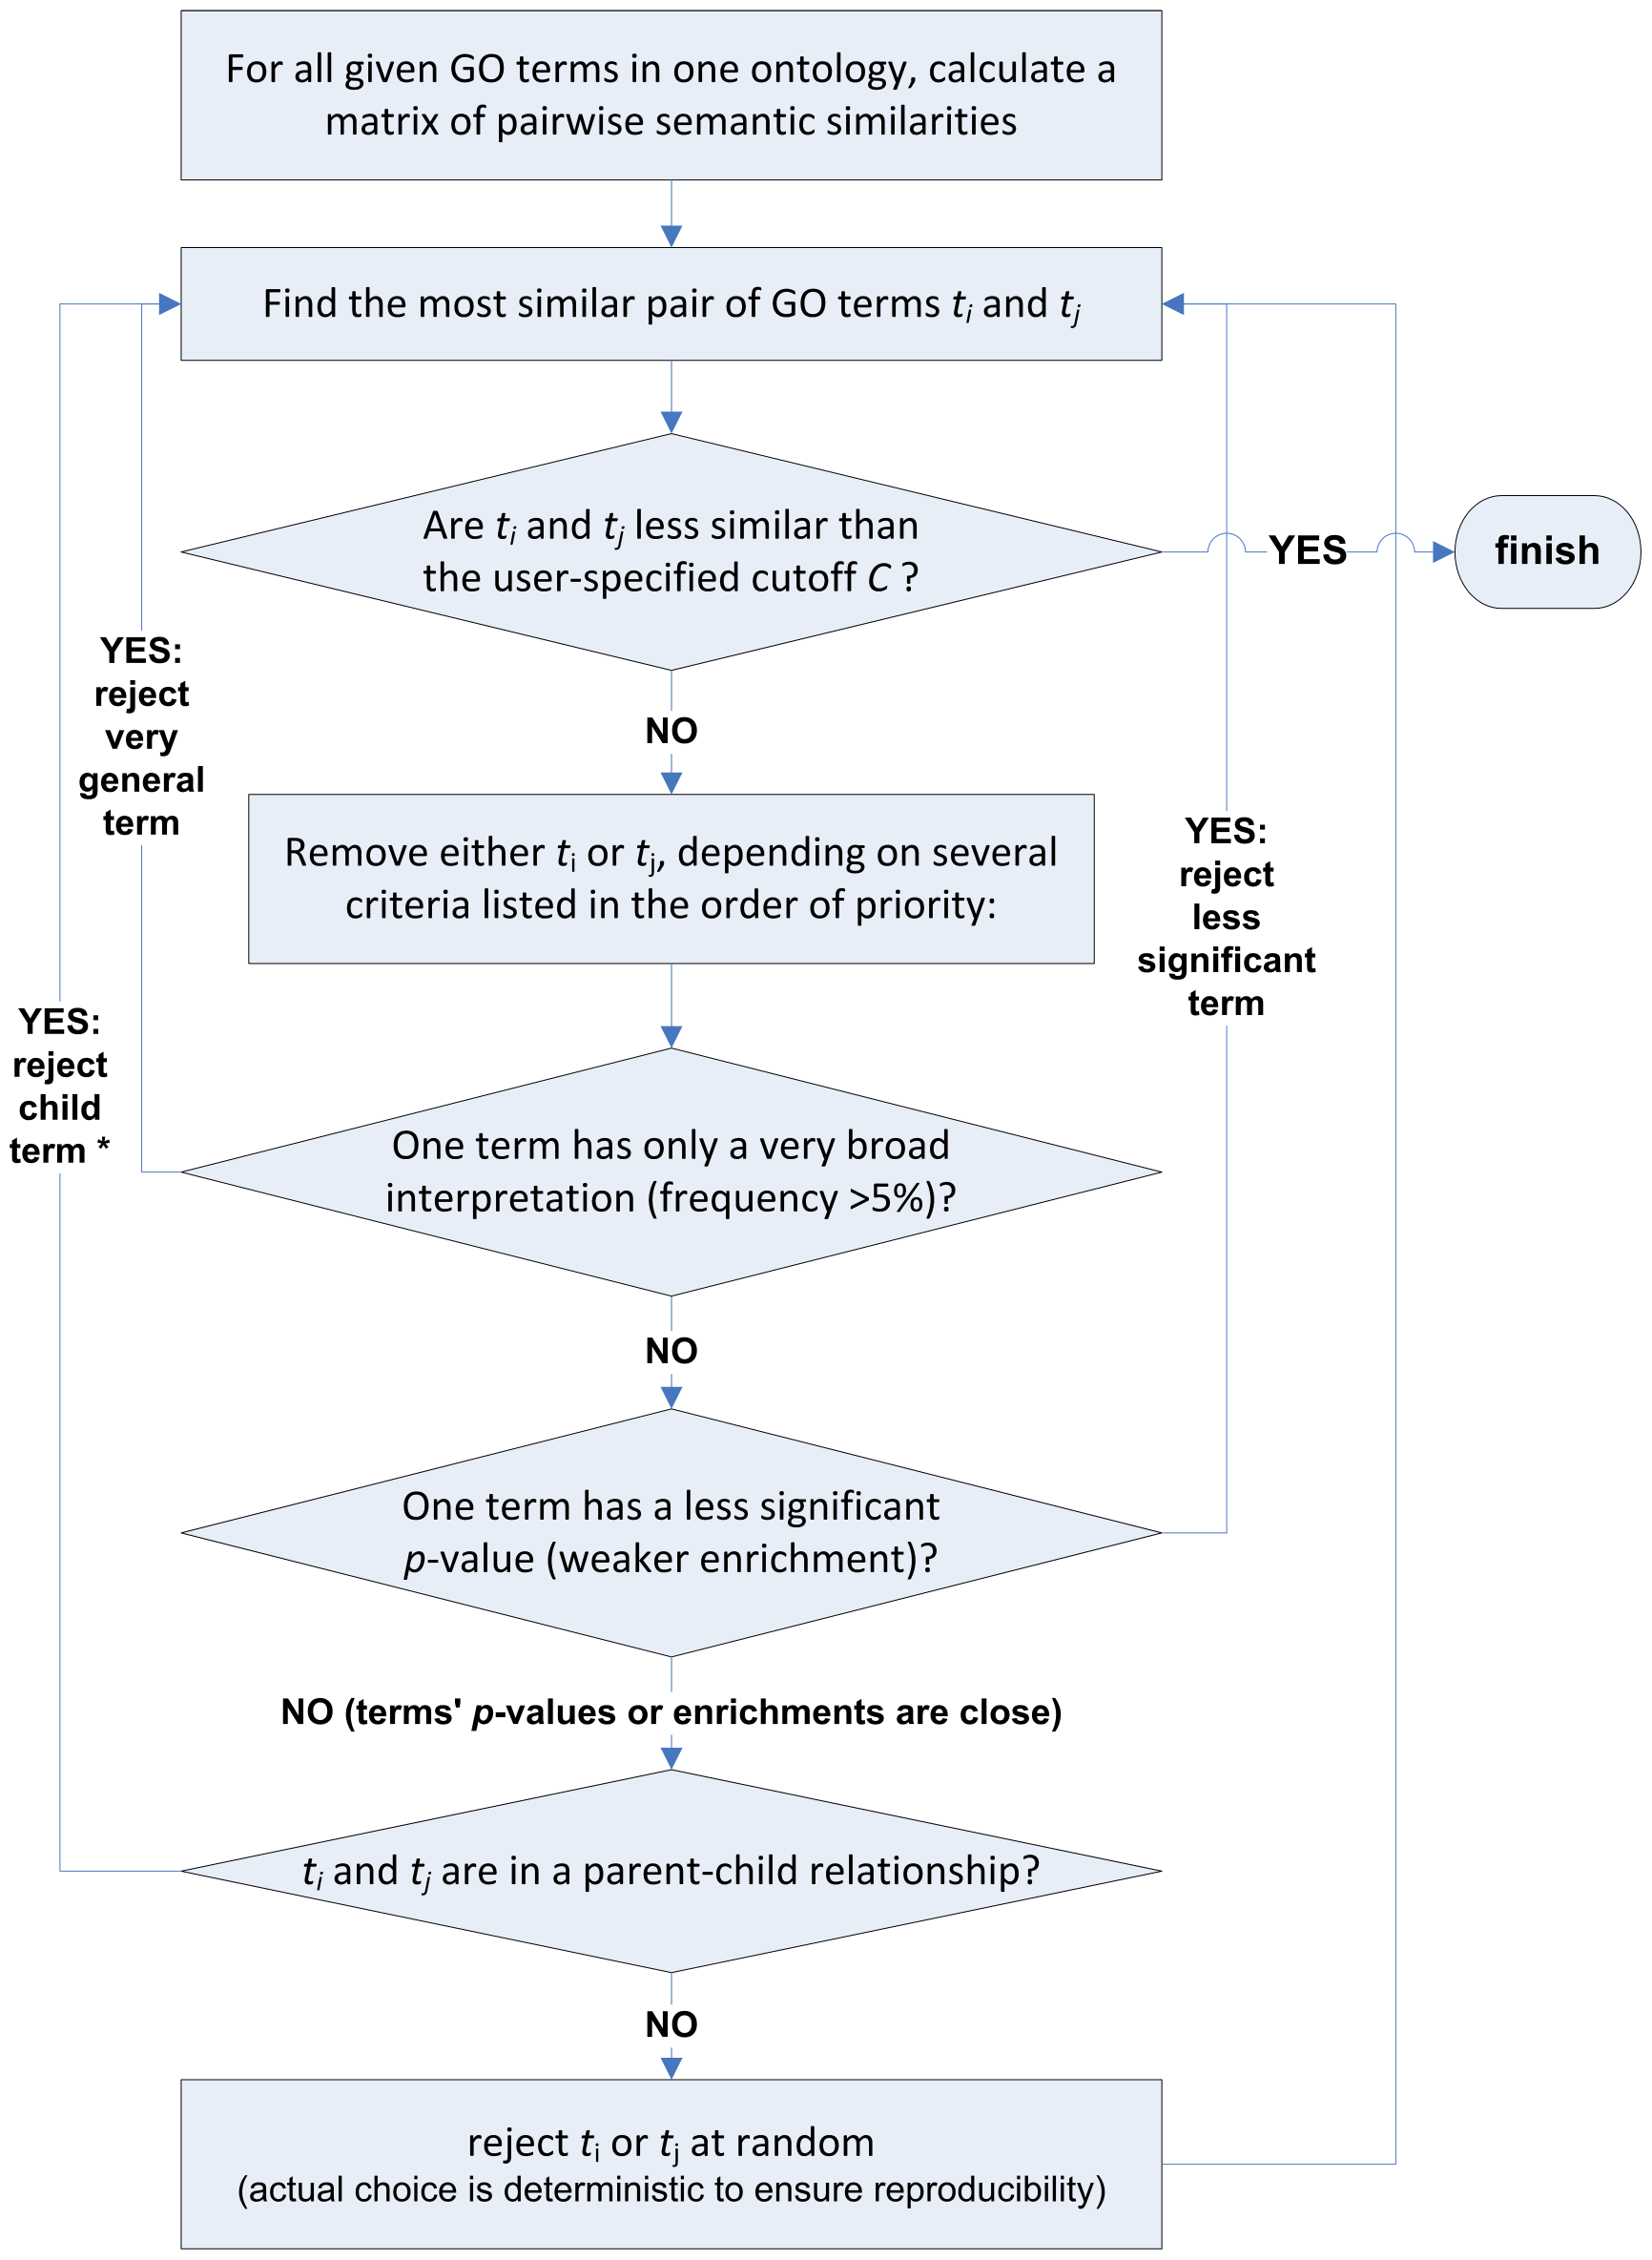
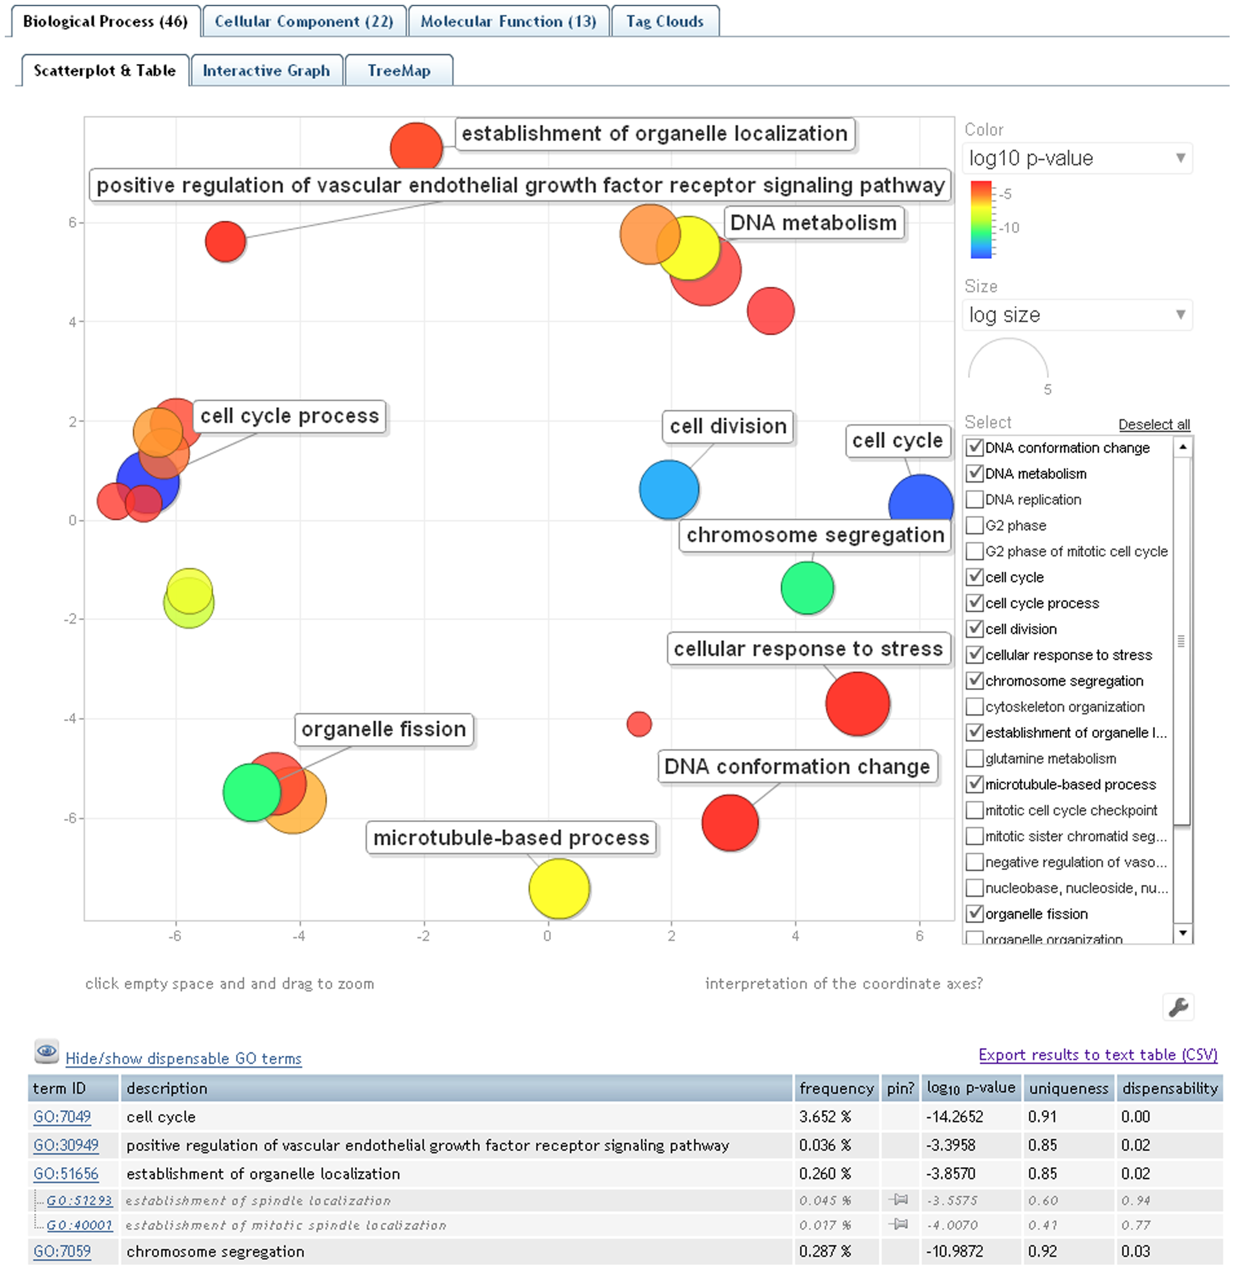
REVIGO - REduction and VIsualization of Gene Ontology
Notes:
REVIGO is a Web server that summarizes long, unintelligible lists of GO terms by finding a representative subset of the terms using a simple clustering algorithm that relies on semantic similarity measures. Furthermore, REVIGO visualizes this non-redundant GO term set in multiple ways to assist in interpretation: multidimensional scaling and graph-based visualizations accurately render the subdivisions and the semantic relationships in the data, while treemaps and tag clouds are also offered as alternative views. REVIGO is freely available at http://revigo.irb.hr/.
The NI4OS-Europe specific on-boarding procedure is described in this document to help the service providers integrate their services in EOSC. The procedure is supported by the necessary templates and documents as well as the preproduction framework used to validate these services and their integration.

Slide 16
REVIGO on-boarding steps into EOSC Federation
Current status: TRL9
EOSC Integration (EIL1-6):
Provide: Basic Service Description, Terms of Use, User manual, Privacy Policy, service PID, training resources
EOSC Federation core service integration:
Helpdesk, accounting and monitoring, EOSC Marketplace
EOSC basic service integration
Do be discussed
Possible integration - HTC, data/storage
Notes:
REVIGO is a Web server that summarizes long, unintelligible lists of GO terms by finding a representative subset of the terms using a simple clustering algorithm that relies on semantic similarity measures. Furthermore, REVIGO visualizes this non-redundant GO term set in multiple ways to assist in interpretation: multidimensional scaling and graph-based visualizations accurately render the subdivisions and the semantic relationships in the data, while treemaps and tag clouds are also offered as alternative views. REVIGO is freely available at http://revigo.irb.hr/.
The NI4OS-Europe specific on-boarding procedure is described in this document to help the service providers integrate their services in EOSC. The procedure is supported by the necessary templates and documents as well as the preproduction framework used to validate these services and their integration.

Slide 17
DARIAH Science Gateway Thematic Service
A web-oriented portal for the researchers and scholars coming from digital arts and humanities disciplines
Developed during the EGI-Engage project (DARIAH Competence Centre) (H2020 EGI-Engage project)
Offers the following services: Semantic and Parallel Semantic Search Engines, DBO@Cloud, Workflow Development, Simple Cloud Access
Integration steps:
Cloud hosting
AAI
Storage
Marketplace
EIL

Slide 18
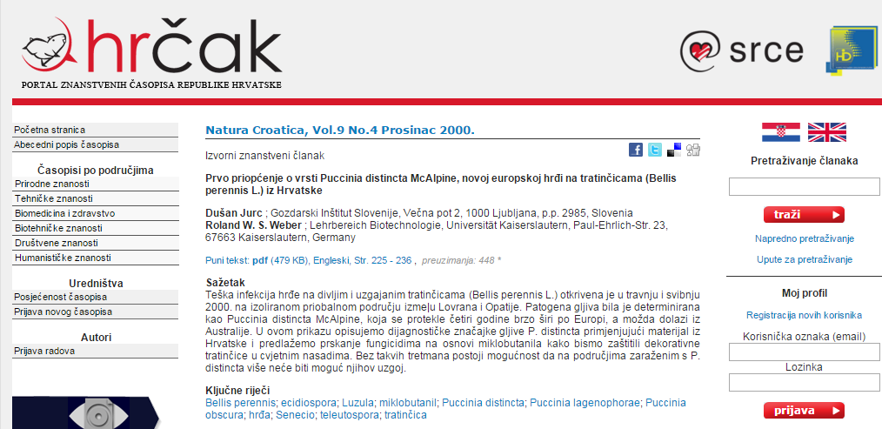
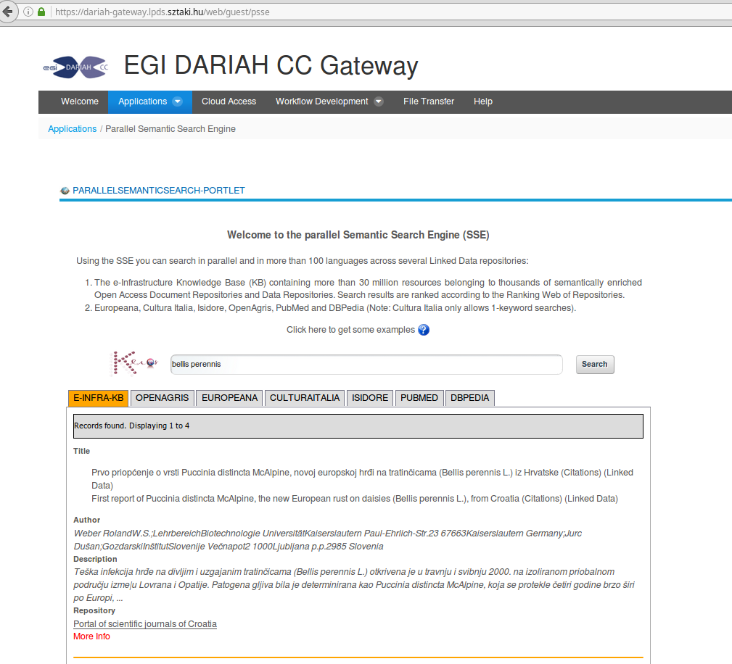
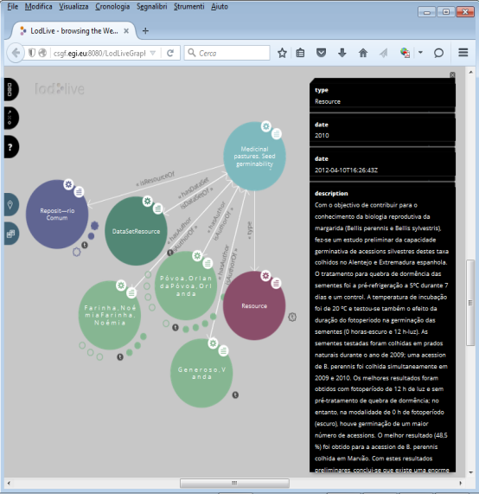
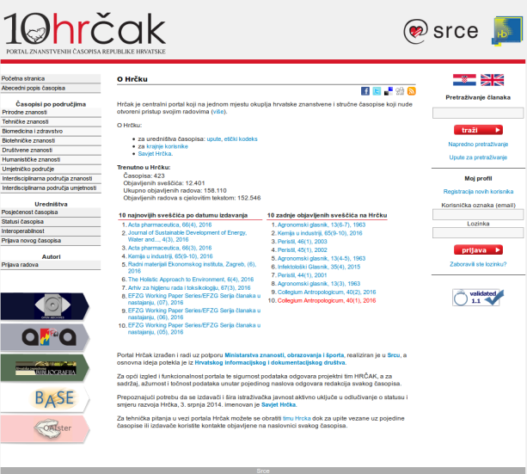
DARIAH Science Gateway - Semantic search service

Slide 19
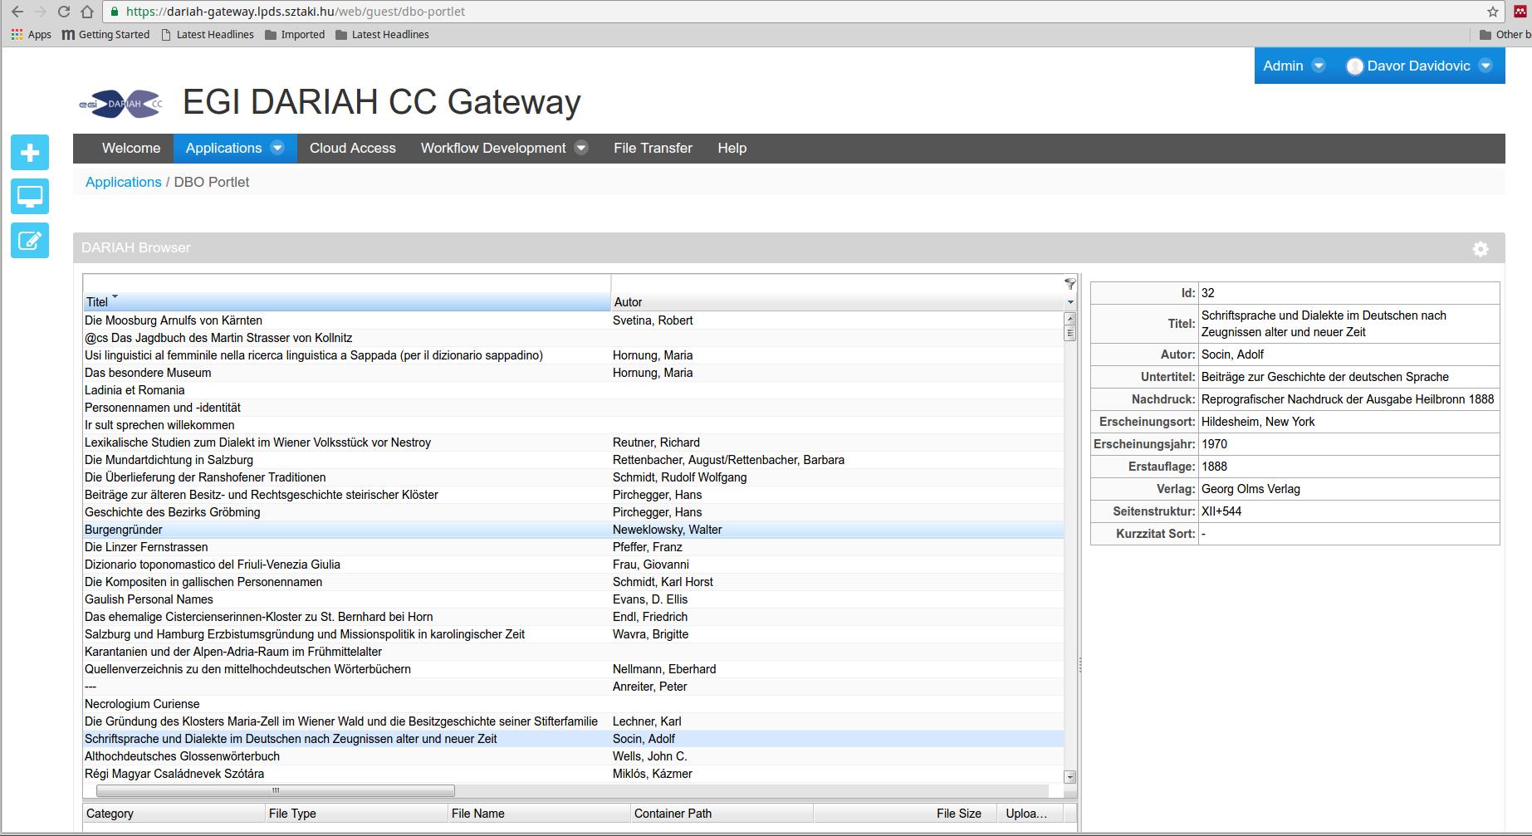
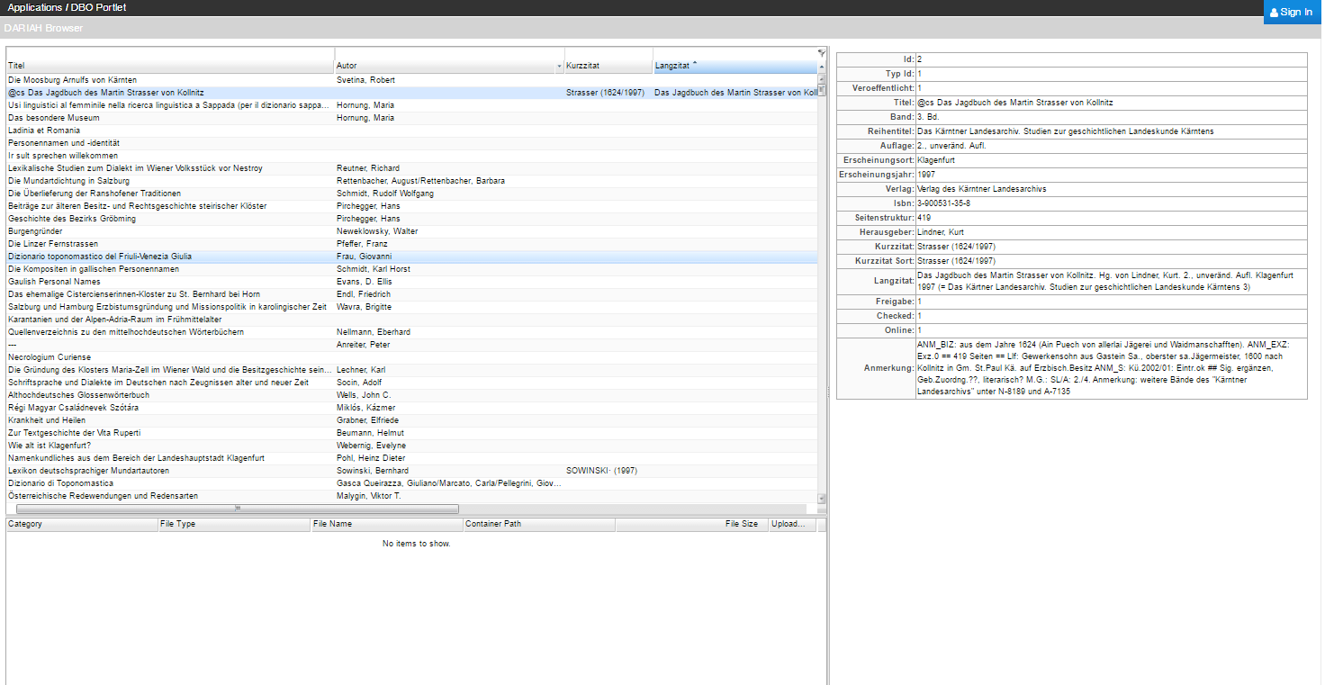
DARIAH Science Gateway - DBÖ@Cloud
100+ years database of the Bavarian dialects dating from the Austria-Hungary monarchy (collected by the Austrian Academy of Science) with 50,000+ records
Functionality: browse, search and download

Slide 20
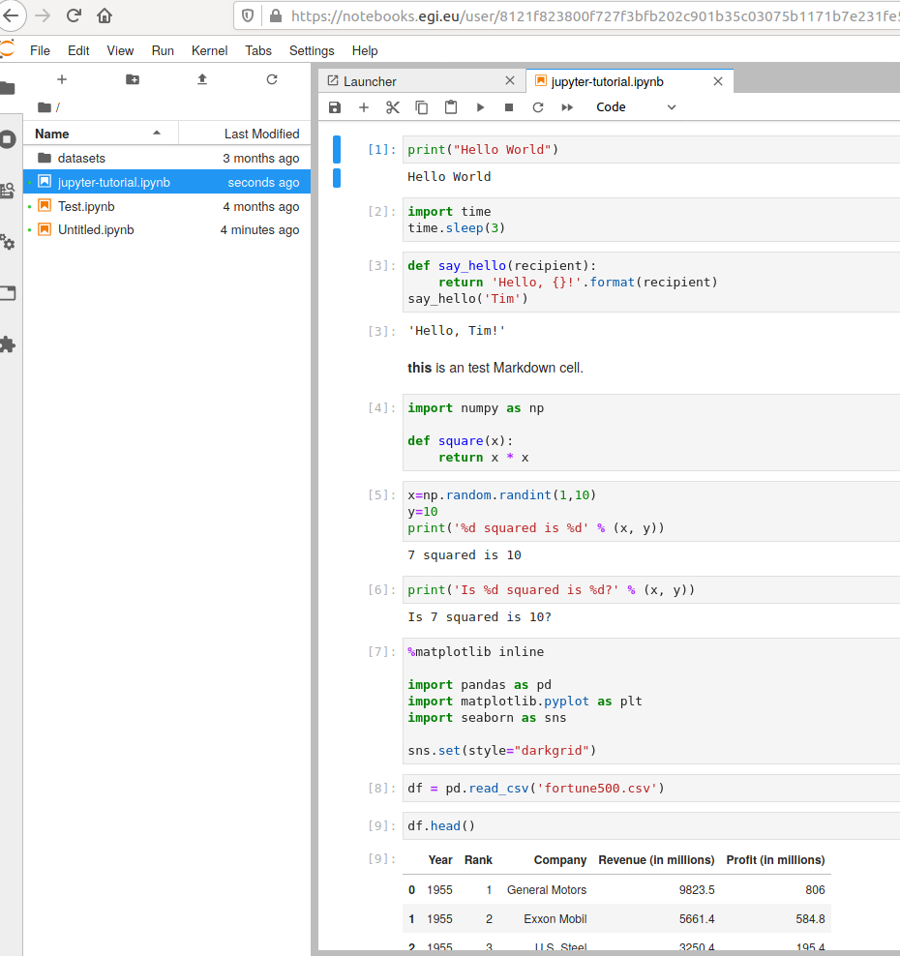
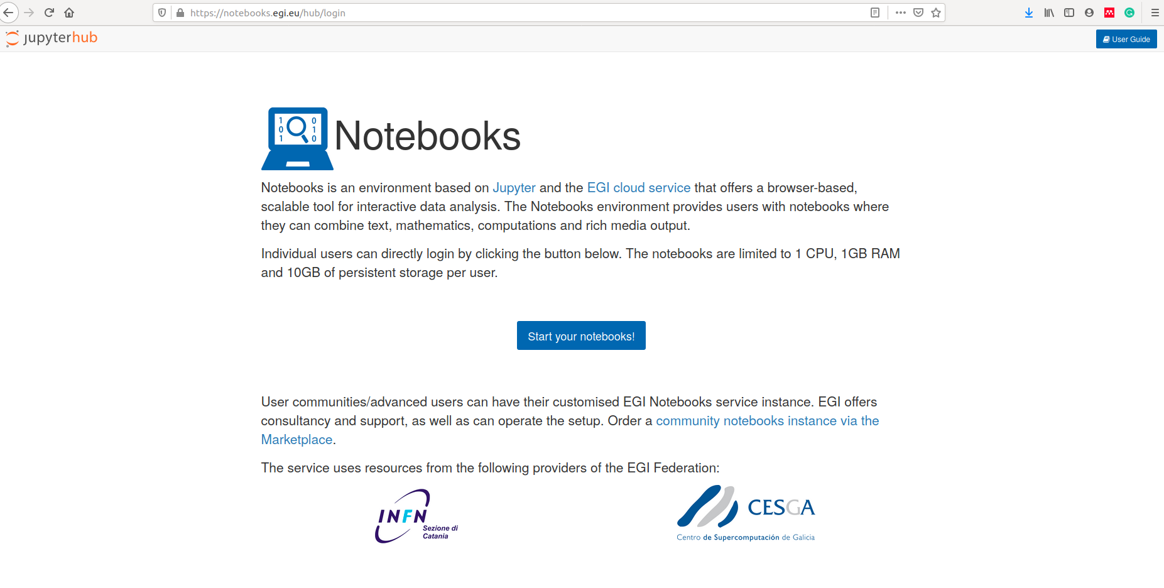
EGI Notebook generic service
Online tool for interactive data analysis using Python, R, Octave, and Julia
https://marketplace.eosc-portal.eu/services/egi-notebooks

Slide 21
EOSC Marketplace - one-stop-shop for EOSC compatible services
Web portal for easy access to services and resources for varous research domains
Examples:
CLARIN Virtual Language Observatory: https://marketplace.eosc-portal.eu/services/virtual-language-observatory
DARIAH Science Gateway: https://marketplace.eosc-portal.eu/services/dariah-science-gateway
https://marketplace.eosc-portal.eu/

Slide 22
Thanks!
NI4OS_eu
NI4OS
ni4os.eu

