Slide 1
Role of national e-Infrastructure in OS
Emir Imamagić, Srce, Head of Computer Systems Department
National Capacity Building Webinar Croatia, PUBMET2020 Conference, September 16 2020

Slide 2
Content
e-Infrastructure
SRCE
Infrastructures in Research Data Lifecycle
International Collaboration

Slide 3
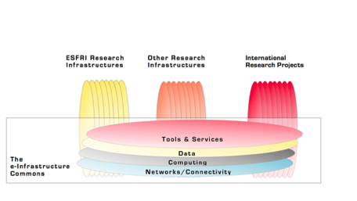
e-IRG e-Infrastructure Commons
The e-Infrastructure Commons can be defined as the integrated living ecosystem of resources and services (along with its policies and governance) that is open, user friendly and accessible to European researchers and scientists, and continuously adapts to the changing requirements of research and science.
Source: e-IRG

Slide 4
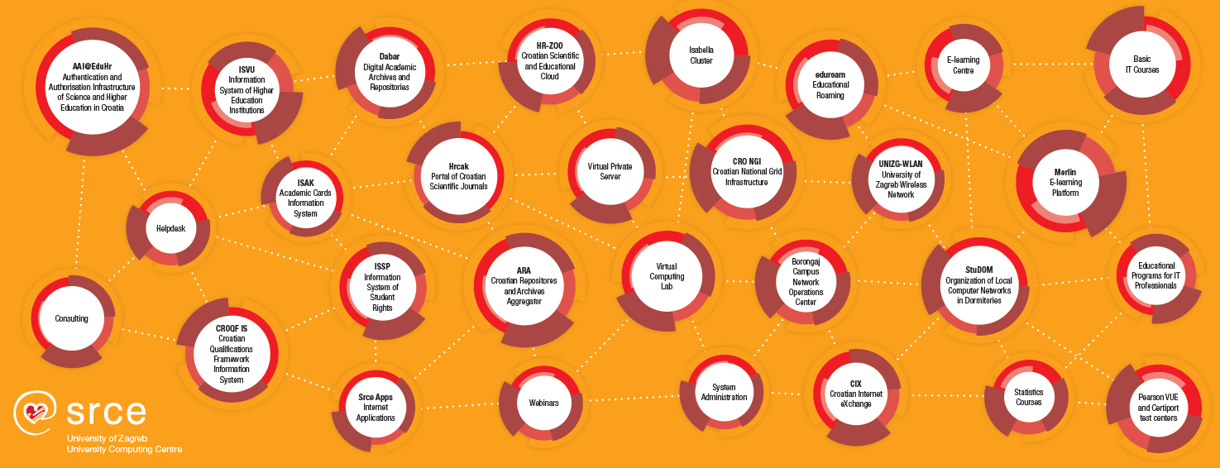
SRCE
e-infrastructure – reliable digital services & access to state-of-the-art ICT
education – enabling users to use ICT & support usage of ICT
knowledge, expertise, support, cooperation in education and research
~ 50 services
140 employees
2 data centers
3 locations in Zagreb
24/365 availability

Slide 5
Infrastructures in Research Data Lifecycle
Plan
Computing infrastructure
HPC cluster Isabella
HTC Cloud
Data infrastructures and services
Puh
Dabar
National Projects (in progress)
HR-ZOO
CroRIS
Reuse
Create
Publish & share
Process
Preserve
Analyze
Notes:
Živimo u doba ‘big data’. Modernu znanost karakteriziraju: pristup do sve veće količine podataka, povećana složenost istraživačkih projekata, povećana multi-disciplinarnost te sve veća očekivanja okoline od znanosti.
Standardni ciklus podatkovnog-znanstvenika prikazan je na slici…planiranje->prikupljanje
Svoju prezentaciju ćemo stoga prilagoditi životnom ciklusu istraživačkih podataka te vam u slijedećih par slajdova ukratko prezentirati kako vam Srce može pomoći u vašem znanstvenom životu…
Konkretno, kroz prikaz usluga naprednog računanja i usluga upravljanja podacima vašeg istraživačkog rada.
Usluge su za vas besplatne ☺

Slide 6
Computing Infrastructure – Isabella
Plan
HPC resource available to Croatian researchers
established in 2002., used in preparations of ~200 publications
currently provides ~140 TFLOPs with CPU & GPU
currently used by 118 projects, user jobs used 2.500 CPU-years in 2019.
regular user workshops
User applications provided
Compilers – Intel, GNU, NVIDIA, PGI
application libraries – MPI, CUDA
~50 scientific applications
chemistry, biology, physics, math
machine learning (GPUs)
Abinit, Gaussian, Gromacs, Quantum Espresso, Tensorflow, MS .NET
https://www.srce.unizg.hr/isabella/
Reuse
Create
Publish & share
Process
Preserve
Analyze
Notes:
Živimo u doba ‘big data’. Modernu znanost karakteriziraju: pristup do sve veće količine podataka, povećana složenost istraživačkih projekata, povećana multi-disciplinarnost te sve veća očekivanja okoline od znanosti.
Standardni ciklus podatkovnog-znanstvenika prikazan je na slici…planiranje->prikupljanje
Svoju prezentaciju ćemo stoga prilagoditi životnom ciklusu istraživačkih podataka te vam u slijedećih par slajdova ukratko prezentirati kako vam Srce može pomoći u vašem znanstvenom životu…
Konkretno, kroz prikaz usluga naprednog računanja i usluga upravljanja podacima vašeg istraživačkog rada.
Usluge su za vas besplatne ☺

Slide 7
Computing Infrastructure – HTC Cloud
Plan
Platform for advanced computing & analysis based on cloud computing
flexible deployment of custom user applications
currently provides 2.400 vCPUs (600 real), 4,7 TB RAM i 150 TB storage
Applications
big data analysis – Hadoop, Spark, Storm
JupyterLab notebooks + Rstudio
elastic HPC clusters or custom systems
https://www.srce.unizg.hr/cro-ngi/
Reuse
Create
Publish & share
Process
Preserve
Analyze
Notes:
Živimo u doba ‘big data’. Modernu znanost karakteriziraju: pristup do sve veće količine podataka, povećana složenost istraživačkih projekata, povećana multi-disciplinarnost te sve veća očekivanja okoline od znanosti.
Standardni ciklus podatkovnog-znanstvenika prikazan je na slici…planiranje->prikupljanje
Svoju prezentaciju ćemo stoga prilagoditi životnom ciklusu istraživačkih podataka te vam u slijedećih par slajdova ukratko prezentirati kako vam Srce može pomoći u vašem znanstvenom životu…
Konkretno, kroz prikaz usluga naprednog računanja i usluga upravljanja podacima vašeg istraživačkog rada.
Usluge su za vas besplatne ☺

Slide 8
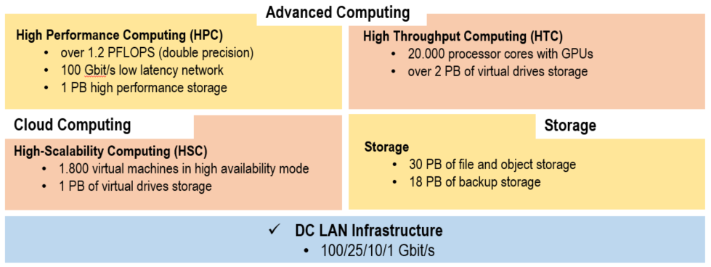
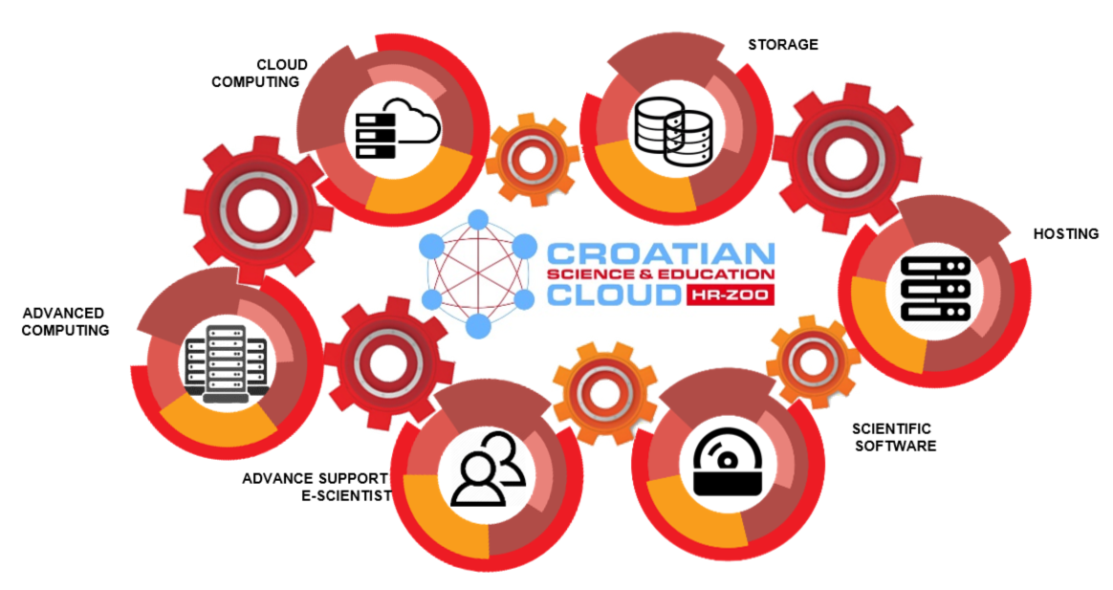
Croatian Scientific and Educational cloud
User: University Computing Centre
Code: KK.01.1.1.08.0001
Total value: 196.802.438,11 HRK
EU funding: 167.282.072,40 HRK
Project start: 18. July 2018.
Project end: 1. September 2021.*
Project objective:
To build a distributed national e-infrastrcuture consisting of computing, storage and network resouces for the purpose of building the RDI capacity of the Croatian A&R community.
Europska unija
Zajedno do fondova EU
Notes:
A budućnost je ..nadamo se ne tako daleka..
Gradimo e-infrastrukturu koja će odgovoriti budućim (podatkovnim) potrebama hrvatske znanosti i visokog obrazovanja.
Sve komponente pa tako i napredne računalne (HPC i HTC) dići red veličine... Na Borongaju izgraditi data centar od 1MW!!
* Napomena: kašnjenje zbog ponavljanja nabave radova na uređenju podatkovnih centara, sjedišta HR-ZOO, Novi planirani datum je Q3/2022 produkcija
napomenuti znanstveni SW

Slide 9
Data infrastructures and services – Puh
Plan
Storage & sharing
data during research or education
educational materials + integration with e-Learning systems
Features
200 GB per user
web interface, desktop & mobile client, network attached drive
user groups
https://www.srce.unizg.hr/puh/
Reuse
Create
Publish & share
Process
Preserve
Analyze
Notes:
Živimo u doba ‘big data’. Modernu znanost karakteriziraju: pristup do sve veće količine podataka, povećana složenost istraživačkih projekata, povećana multi-disciplinarnost te sve veća očekivanja okoline od znanosti.
Standardni ciklus podatkovnog-znanstvenika prikazan je na slici…planiranje->prikupljanje
Svoju prezentaciju ćemo stoga prilagoditi životnom ciklusu istraživačkih podataka te vam u slijedećih par slajdova ukratko prezentirati kako vam Srce može pomoći u vašem znanstvenom životu…
Konkretno, kroz prikaz usluga naprednog računanja i usluga upravljanja podacima vašeg istraživačkog rada.
Usluge su za vas besplatne ☺

Slide 10
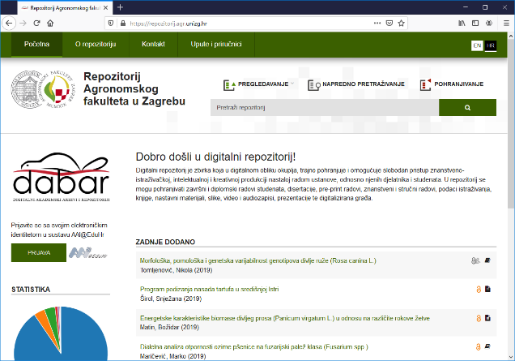
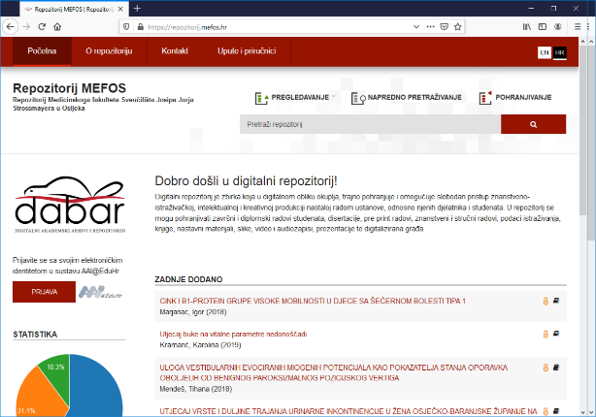
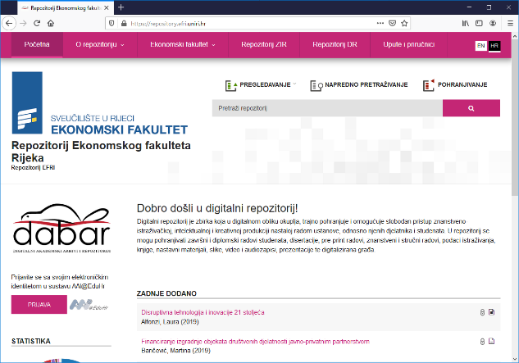
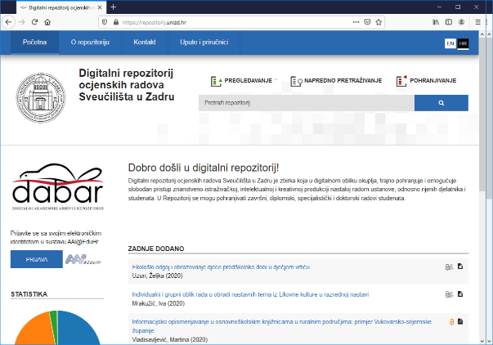
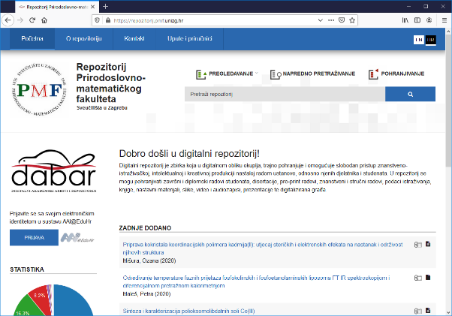
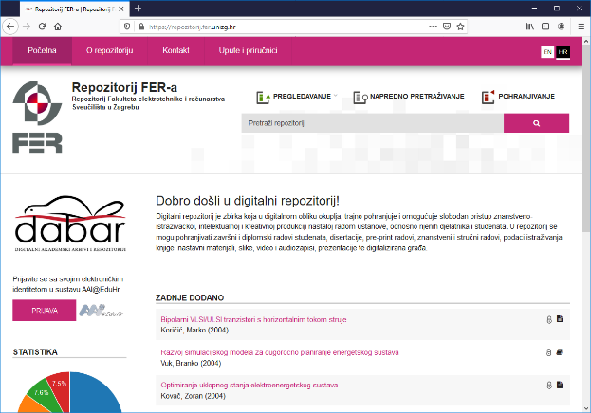
Data infrastructures and services – Dabar
National platform for repositories and archives with the support for research data sharing
Objects
Papers published in proceedings
Book chapters
Conference abstracts and presentations
Other documents: project proposals, plans, reports (technical, project), technical documentation, studies,...
Research data
Educational material
Undegraduate and master's theses, dissertations
Art (photography, audio and video)
142 repositories, 129.000+ objects
Plan
Reuse
Create
Publish & share
Process
Preserve
Analyze
https://dabar.srce.hr/repozitoriji/

Slide 11
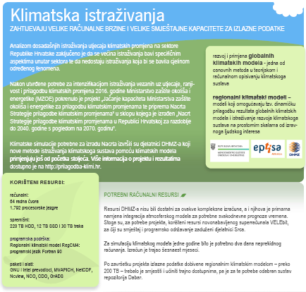
Data infrastructures and services – Dabar
Infrastructure for FAIR data
Findable (PID, rich metadata, search funct., services)
Accessible (HTTP)
Interoperable (open formats, MODS/DC/DataCite, links)
Re-usable (License, domain standards?)
Research data (datasets)
Croatian Meteorological and Hydrological Service
RegCM4 Climate Change Adaptation Simulations
Ruđer Bošković Institute
The Institute of Economics Zagreb
Faculty of Humanities and Social Sciences

Slide 12
CroRIS - Croatian Research Information System
CroRIS is the new national CRIS being implemented in Croatia
Information and processes about institutions, researches, projects, publications, equipment, patents, events and much more
Built specifically for Croatian environment, it will integrate with many national systems and international platforms, such as ORCID, OpenAire, WoS, Scopus
The base for informed decision making
Promoting open science
Gradually being put in production, aimed to finish in 2022
Funded 85% by EU
Part of the Scientific and Technological Foresight project, led by Ministry of Science and Education

Slide 13
International Collaboration
provide compute, connectivity and data services for open science
create and connect National HPC Competence Centres
support for the inclusion of services and repositories in EOSC
global organization that promotes and supports data sharing

Slide 14
Thank You!

