Slide 1
National Initiatives for Open Science in Europe
National Capacity Building NI4OS Training
“Fair play” in the scientific playground
- HR -
16 September 2020
Alen Vodopijevec Rudjer Boskovic Institute

Slide 2
Long “tradition” of research data sharing
1985.
87% would share their data on demand
59% claims that their colleagues were not willing to share the data !?? :-)
Social sciences: publication concerns - losing the race with time
Biotechnological fields: financial concerns - losing patents, new projects..
Ceci, S. J. Scientists’ Attitudes toward Data Sharing. Science, Technology, & Human Values 13, 45–52 (1988). https://doi.org/10.1177%2F0162243988013001-206
“Thus this appears to be the right time for those of us responsible for the training of future generations of scientists to introduce into our training some activities designed to inculcate the hallmark norms of science, including data sharing.”

Slide 3
Data management and curation.. But why?
Data archived and accessible
Re-use, validation of results, education
Lowering research expenses by reusing data
Speeding up the research process
Reporting made easy (DMP)
Getting more impact

Slide 4
Good practice examples
Data curation tradition in social sciences: CESSDA ERIC
Genomics, paleogenetics, astrophysics, meteorology ..
1990. Human genome sequencing
1996. “Bermuda principles”
2003. Project successfully finished
http://www.genome.gov/10001772
http://unlockinglifescode.org/timeline?tid=4
ftp://ftp.ensembl.org/pub/release-77/fasta/homo_sapiens/dna/

Slide 5
“Fair play” in the Science playground
Developing the infrastructure, implementing policies and acquiring new skills and competences to be able to manage data having FAIR principles in mind.

Slide 6
FAIR
To be Findable:
F1. (meta)data are assigned a globally unique and persistent identifier
F2. data are described with rich metadata (defined by R1 below)
F3. metadata clearly and explicitly include the identifier of the data it describes
F4. (meta)data are registered or indexed in a searchable resource
[​ https://www.force11.org/group/fairgroup/fairprinciples​ ]
[​ Wilkinson et al, (2016) ‘The FAIR Guiding Principles for scientific data management and stewardship’, Scientific Data 3:160018, ​ https://doi.org/10.1038/sdata.2016.18​, e.g. at https://www.researchgate.net/publication/298345883_The_FAIR_Guiding_Principles_for_scientific_data_management_and_stewardship​ ]

Slide 7
FAIR
To be Accessible:
A1. (meta)data are retrievable by their identifier using a standardized communications protocol
A1.1. the protocol is free, open and universally implementable
A1.2. the protocol allows for an authentication and authorization procedure, where necessary
A2. metadata are accessible, even when the data are no longer available

Slide 8
FAIR
To be Interoperable:
I1. (meta)data use a formal, accessible, shared, and broadly applicable language for knowledge representation
I2. (meta)data uses vocabularies that follow FAIR principles
I3. (meta)data include qualified references to other (meta)data

Slide 9
FAIR
To be reusable:
R1. (meta)data are richly described with a plurality of accurate and relevant attributes
R1.1. (meta)data are released with a clear and accessible data usage license
R1.2. (meta)data are associated with data provenance
R1.3. (meta)data meet domain relevant community standards

Slide 10
In the long run … 2018..
Changes in rewarding and advancement systems in science
Encourage publishing of “negative results”
Promoting Open Science principles and raising the awareness on the benefits of sharing research data (especially among young researchers)
formal vs. unformal data citation
Funders policies
Boulbes, D. R. et al. A Survey on Data Reproducibility and the Effect of Publication Process on the Ethical Reporting of Laboratory Research. Clin Cancer Res 24, 3447–3455 (2018). https://doi.org/10.1158%2F1078-0432.ccr-18-0227
Park, H., You, S. & Wolfram, D. Informal data citation for data sharing and reuse is more common than formal data citation in biomedical fields. Journal of the Association for Information Science and Technology 69, 1346–1354 (2018).

Slide 11
Infrastructure
Technical (FAIR)
Subject and disciplinary repositories https://www.re3data.org/
Zenodo platform (OpenAIRE) https://www.zenodo.org
OpenAIRE portal: http://www.openaire.eu
Institutional repositories
DABAR https://dabar.srce.hr
FULIR RBI http://fulir.irb.hr
Organizational (FAIR)
Data services, Libraries
acquiring new skills and competences to be able to manage data having FAIR principles in mind.

Slide 12
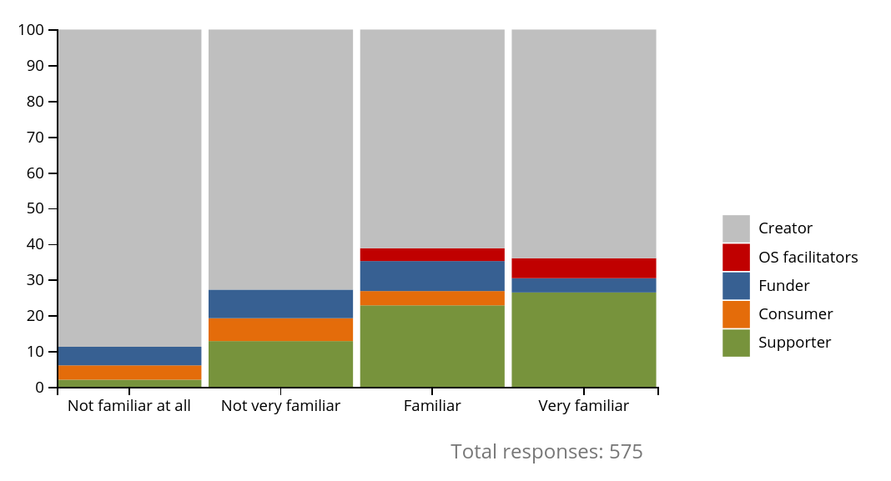
NI4OS Landscape study
How familiar are you with the concept of FAIR regarding data?
https://ni4os.eu/survey-results/

Slide 13
Mission
Support the development and inclusion of the national Open Science Cloud (OSC) initiatives in 15 Member States and Associated Countries in the overall scheme of EOSC governance
Spread the EOSC and FAIR principles in the community and train it
Provide technical and policy support in on-boarding of the existing and future service providers into EOSC

Slide 14
ORDM / FAIR tools and certification schemes (WP4)
Implementation and adoption of tools, standards and guidelines
Selection and delivery of tools
Harmonisation and interoperability within and across communities and with core initiatives
Development and application of certification schemes
Elaboration of incentives to support ORDM and FAIR

Slide 15
Playing FAIR
Cooperation
Competition

Slide 16
Thanks!
NI4OS_eu NI4OS ni4os.eu

