Slide 1
Life Sciences Thematic Services of the Open Call
NI4OS-Europe Open Call Training Event
14 April 2022
Dr. Zoe Cournia
Life Science Coordinator
Biomedical Research Foundation
Academy of Athens
Greece

Slide 2
NI4OS-Eurpe on-boarded/candidate LS Thematic Services
ChemBioServer 2.0
FEPrepare
DREAMM
Nanocrystal
Ingredio
OpenBioMaps
REVIGO
EEGHUB
DICOM
MelGene

Slide 3
Drug discovery tools onboarded on NI4OS-Europe
http://chembioserver.vi-seem.eu/
http://dreamm-ni4os.eu/
http://feprepare.vi-seem.eu
http://nanocrystal-seem.eu

Slide 4
ChemBioServer: A drug discovery tool
http://feprepare.vi-seem.eu
http://chembioserver.vi-seem.eu/
Notes:
FEP prepare is a webserver, which automates the set-up procedure for performing NAMD/FEP simulations. ​Automating free energy perturbation calculations is a step forward to delivering high throughput calculations for accurate predictions of relative binding affinities before a compound is synthesized, and consequently save enormous time and cost.

Slide 5
ChemBioServer: A drug discovery tool
Information in NI4OS-Europe Agora: https://catalogue.ni4os.eu/?_=/resources/d06512f9-b287-4452-8a2f-5742eccb44c4
Access: http://chembioserver.vi-seem.eu/
Training Material: https://training.ni4os.eu/mod/scorm/view.php?id=1186

Slide 6
FEPrepare: A lead optimization tool
http://feprepare.vi-seem.eu
Notes:
FEP prepare is a webserver, which automates the set-up procedure for performing NAMD/FEP simulations. ​Automating free energy perturbation calculations is a step forward to delivering high throughput calculations for accurate predictions of relative binding affinities before a compound is synthesized, and consequently save enormous time and cost.

Slide 7
FEPrepare: A lead optimization tool
Information in NI4OS-Europe Agora: https://catalogue.ni4os.eu/?_=/resources/4d2f5c58-d32d-46ce-b075-8b278889fe96
Access: https://feprepare.vi-seem.eu/
Training Material https://training.ni4os.eu/mod/scorm/view.php?id=1183

Slide 8
DREAMM: Predicting cavities at protein-membrane interfaces
http://dreamm-ni4os.eu/

Slide 9
DREAMM: Predicting cavities at protein-membrane interfaces
Information in NI4OS-Europe Agora: https://catalogue.ni4os.eu/?_=/resources/bc445004-2869-43c9-9ef3-e5aa6b44d2e3
Access: https://dreamm.ni4os.eu/
Training Material: https://training.ni4os.eu/mod/scorm/view.php?id=1187

Slide 10
Nanocrystal: construction of nanoparticles for simulation
http://nanocrystal-seem.eu
Notes:
FEP prepare is a webserver, which automates the set-up procedure for performing NAMD/FEP simulations. ​Automating free energy perturbation calculations is a step forward to delivering high throughput calculations for accurate predictions of relative binding affinities before a compound is synthesized, and consequently save enormous time and cost.

Slide 11
Nanocrystal: construction of nanoparticles for simulation
Information in NI4OS-Europe Agora: https://catalogue.ni4os.eu/?_=/resources/c1f8d7fb-4250-4278-ba8d-4d1df4a85df5
Access: http://nanocrystal-seem.eu
Training Material: https://training.ni4os.eu/mod/scorm/view.php?id=1181

Slide 12
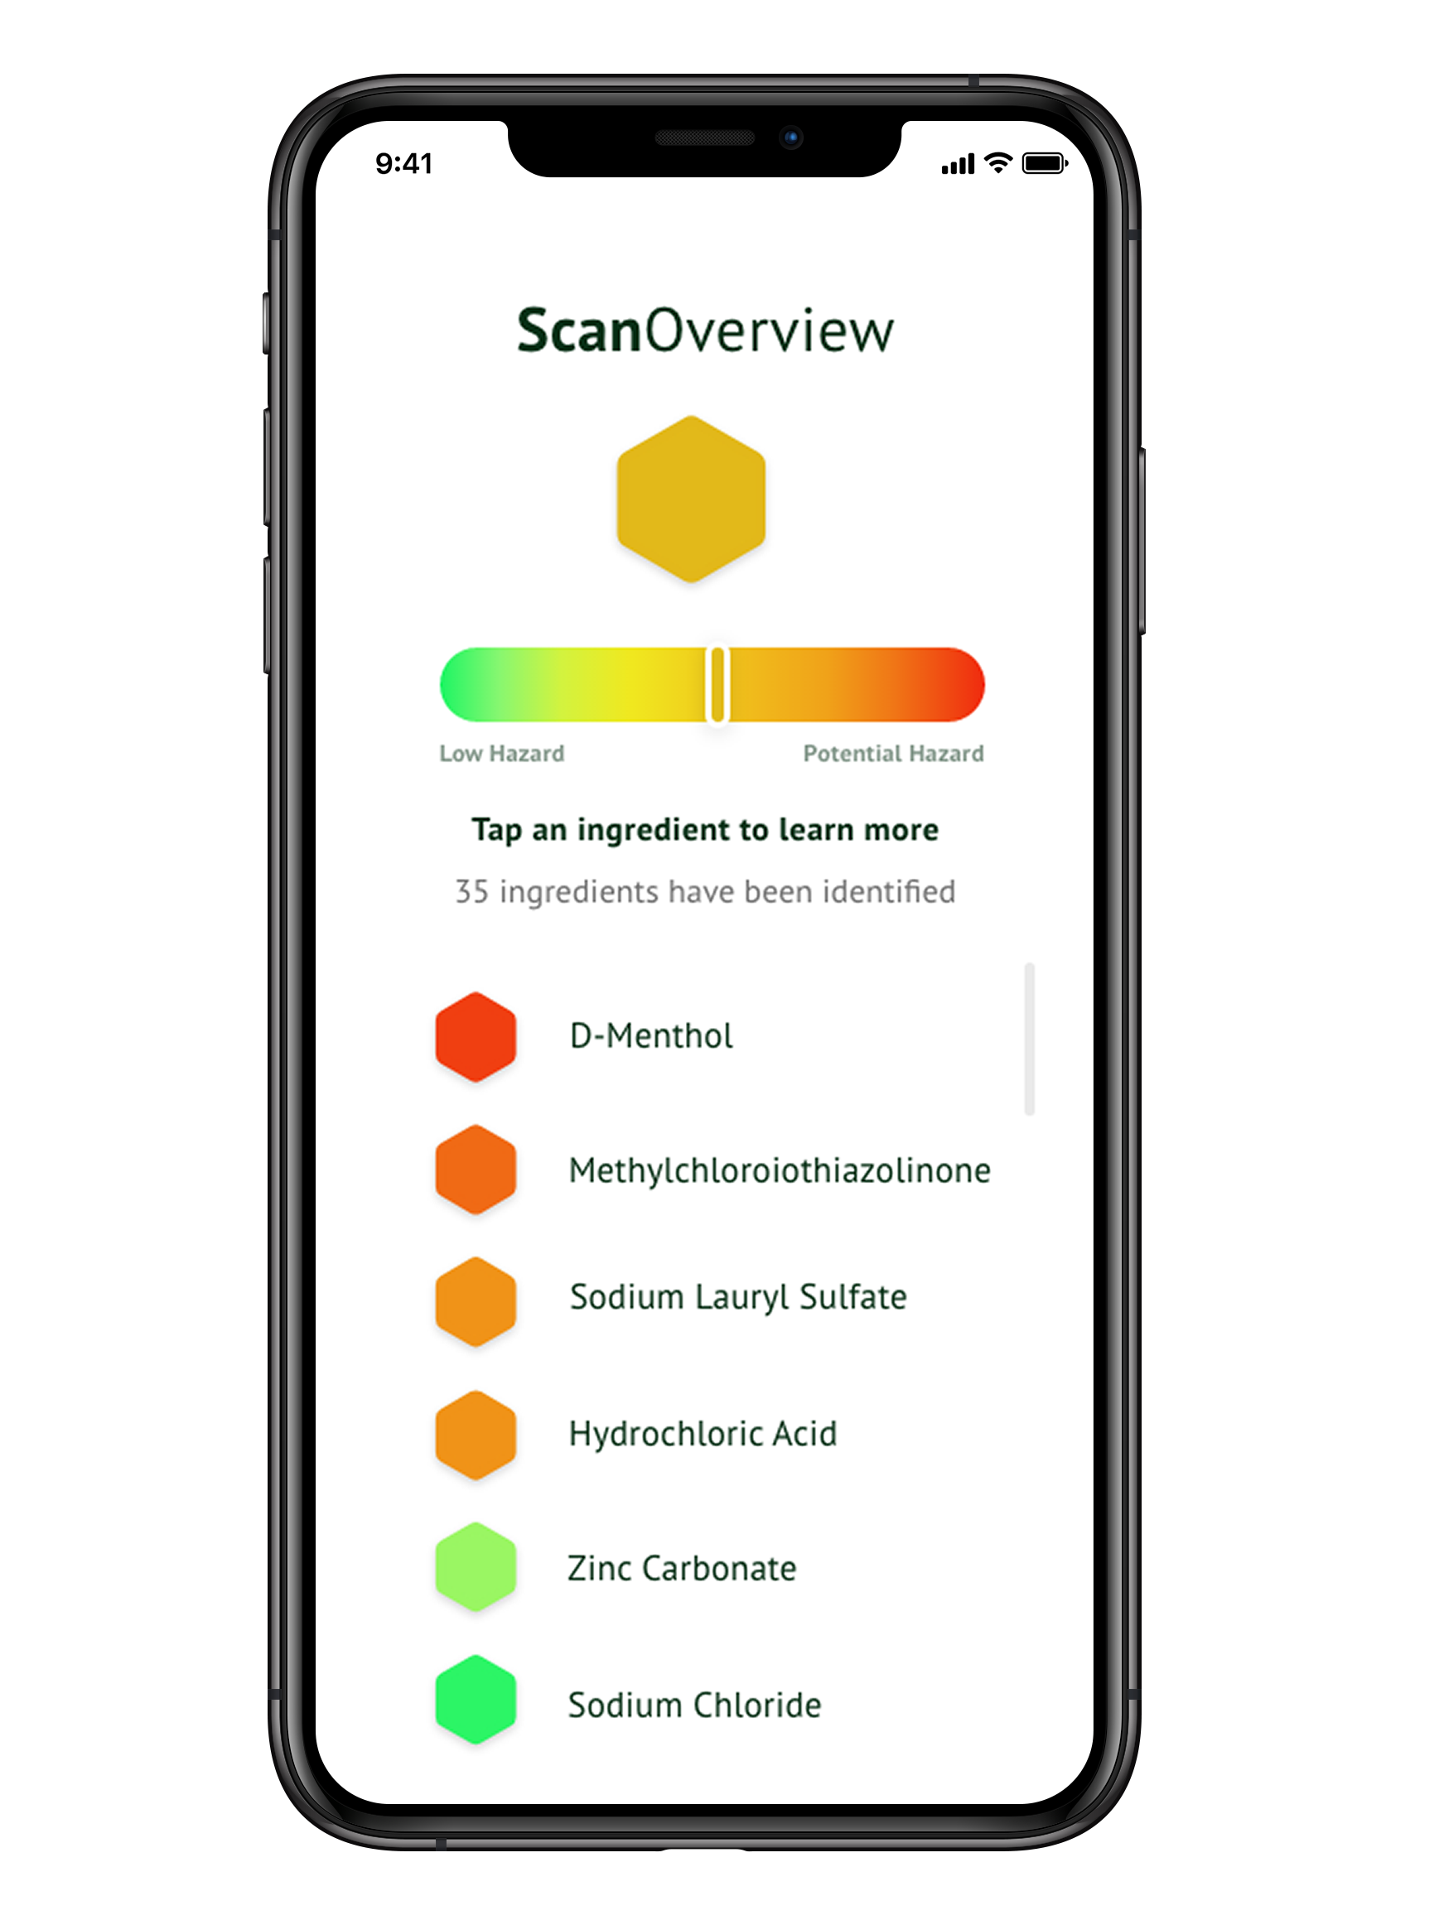
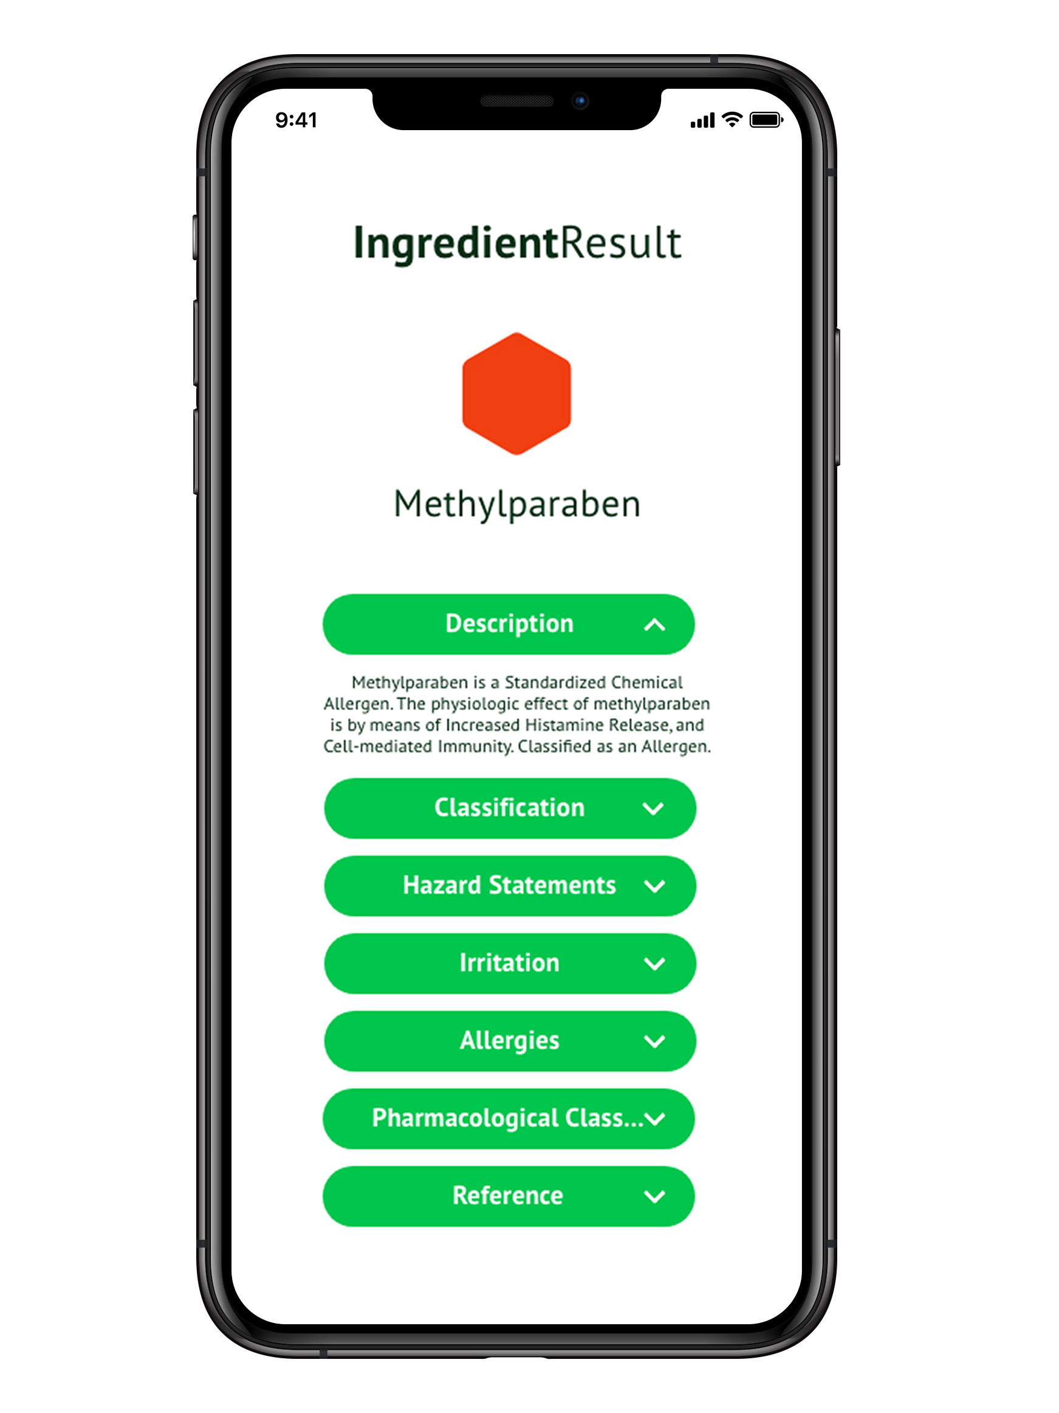
Ingredio: Users can check if the product has ingredients with potential hazards for human health
Unique proprietary scientific algorithms & scoring function
Level of hazard per ingredient*
* Information sourced from institutional databases
Notes:
Goal 1: Develop text mining and Machine Learning algorithms to extract OpenAIRE data linking chemical ingredients of food &cosmetics to potential health hazards
Goal 2: Support the curation of OpenAIRE data with appropriate metadata schemas for efficient integration of information in the OpenAIRE Research Graph
Goal 3: Identifying new chemical ingredients from OpenAIRE data to enrich the OpenAIRE research graph & the Ingredio database
Goal 4: Identify causal relationships of chemical ingredients with hazards using the collected information

Slide 13
Ingredio: Natural Language Processing to process biomedical text
Information in NI4OS-Europe Agora: https://catalogue.ni4os.eu/?_=/resources/7cc4118c-e637-4463-a841-92831e897368
Access: https://ingredio.ni4os.eu/
Training Material: https://training.ni4os.eu/mod/scorm/view.php?id=1182

Slide 14
OpenBioMaps: Tool to create open and free bio databases
Information in NI4OS-Europe Agora: https://catalogue.ni4os.eu/?_=/resources/1070f91e-96b8-444c-bdaf-40961c40c830
Access: https://openbiomaps.org/?lang=en
Training Material: https://openbiomaps.org/documents/en/

Slide 15
REVIGO: Reduce and Visualize Gene Ontology
Information in NI4OS-Europe Agora: https://catalogue.ni4os.eu/?_=/resources/6d231512-984c-4fe9-933a-842f9d4c9fbe
Access: http://revigo.irb.hr/
Training Material: http://revigo.irb.hr/FAQ.aspx

Slide 16
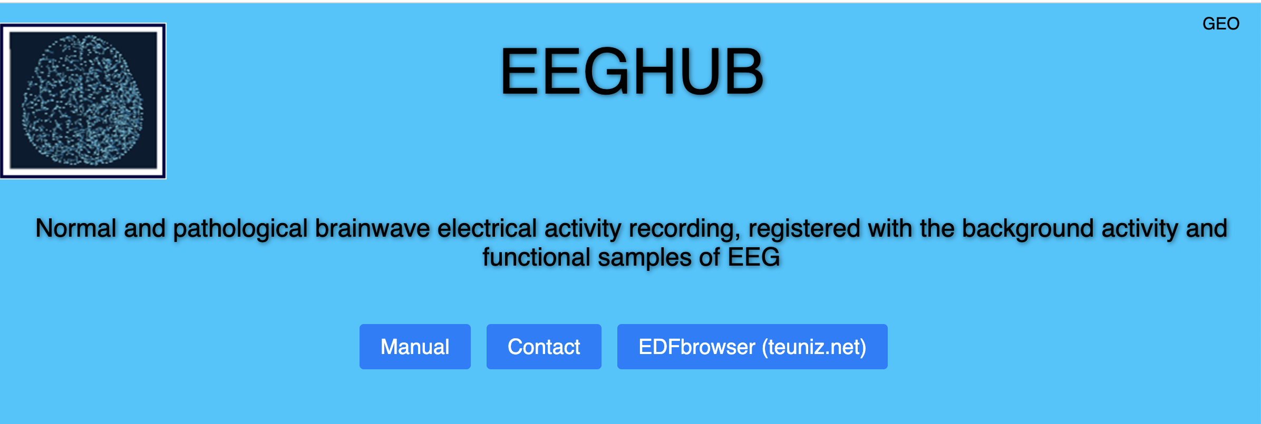
EEGHUB: Big Data EEG online dataset
Information in NI4OS-Europe Agora: https://catalogue.ni4os.eu/?_=/resources/9df4036a-18dd-47c4-8ad9-21c4ab3b8e66
Access: https://eeghub.ge/
Training Material: https://eeghub.ge/manual.pdf

Slide 17
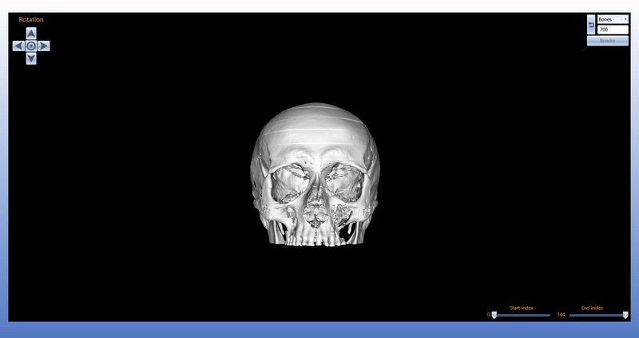
DICOM Network: Portal, Server, Viewer for biomedical images
Information in NI4OS-Europe Agora: https://catalogue.ni4os.eu/?_=/resources/9df4036a-18dd-47c4-8ad9-21c4ab3b8e66
Access: http://www.dicom.md/
Notes:
DICOM Network: collect, process & visualize medical images online
DICOM Portal: Front-end user interface for patients, doctors, scientists
DICOM Server: Collects & archives images to DICOM portal for online access
DICOM Viewer: Image visualizer, edit image operations, 3D modeling, save, print

Slide 18
MelGene: Field Synopsis of Genetic Associations in Melanoma
Information in NI4OS-Europe Agora: https://catalogue.ni4os.eu/?_=/resources/04b06b6f-e3a1-490b-94ea-8a1ab0309213
Access: https://bioinformatics.cing.ac.cy/MelGene/
Training Material: https://bioinformatics.cing.ac.cy/MelGene/Help.html

Slide 19
Use Case Example: Extracting correlations for patient stratification using Machine Learning

Slide 20
Use Case Example: Extracting correlations for patient stratification using Machine Learning
Stratifying patients for melanoma cancer type based on existing, open data
Existing biomarker (omics) datasets
3D reconstruct
with
CHERE
MelGene
Generic Cloud Storage
Generic Cloud Storage
Repository SUMP
Become public through “Clowder4DCH”
Long term Storage at Data Repository
Long term Storage at Data Repository
Leo
GPU cluster
Archival and Simple Storage Service
Become public through “Clowder4DCH”
Machine Learning and AI
3D reconstruct
with
DroneMapper
Bio-Connect
EML
Thematic Service
Generic Service
Storage Service
Storage Service

Slide 21
Thanks for your attention!

