Slide 1
ORDM and FAIR - rewards and incentives
PUBMET 2020 - National Capacity Building NI4OS Europe Training
Bojan Macan, Ph.D., EOSC promotor
Ruđer Bošković Institute, Centre for Scientific Information, Zagreb, Croatia
e-mail: bojan.macan@irb.hr

Slide 2
Task about developing rewards and incentives for ORDM and FAIR
Τ4.1 Developing rewards and incentives mechanisms for ORDM and FAIR – IRB task leader
goal: to define incentives and rewards for ORDM and FAIR
analysis of the current state of ORDM and FAIR in NI4OS-Europe partner’s countries and existing recommendations and initiatives
results: Deliverable D4.1 - Incentives for supporting ORDM and FAIR

Slide 3
Benefits of Open Research Data
http://blogs.nature.com/naturejobs/2017/06/19/ask-not-what-you-can-do-for-open-data-ask-what-open-data-can-do-for-you/

Slide 4
Analysis of the current state
analysis of the current state – NI4OS-Europe landscaping study
surveyed stakeholders from 15 NI4OS-Europe partner’s countries
stakeholders divided into 5 groups:
Funders and policymakers - FUND (n=81)
The ones who perform research - CREATE (n=604)
The ones who support research - SUPPORT (n=304)
The ones who “consume” research - CONSUME (n=115)
OS facilitators (including OS initiatives) - FACILITATE (n=66)
1170 answered questionnaires
Deliverable 2.1 - Stakeholder map, inventory, policy matrix
as a part of T4.1 questions related to incentives and rewards for ORDM and FAIR were analyzed

Slide 5
Importance of certain parameters for evaluation of researchers (FUND, CREATE, CONSUME, and FACILITATE groups)
Source: NI4OS-Europe Deliverable 4.1

Slide 6
Institutional support and training by areas in NI4OS-Europe partner countries (CREATE, SUPPORT, CONSUME, and FACILITATE groups)
Source: NI4OS-Europe Deliverable 4.1

Slide 7
Areas of training, support, or advice which researchers and support staff need to make data FAIR (CREATE, SUPPORT, CONSUME, and FACILITATE groups)
Source: NI4OS-Europe Deliverable 4.1

Slide 8
The importance of open data and open science-related concepts (83 SUPPORT respondents)
Source: NI4OS-Europe Deliverable 4.1

Slide 9
Incentives and rewards for ORDM and FAIR

Slide 10
1. Enforcement of ORDM and FAIR through policies
Key activities:
mandating DPMs
setting up policies for FAIR data archiving and publishing
issuing FAIRness level certificates for repositories
favouring OS practices through research assessment and career advancement criteria
OA publishing, including datasets and software, as a default
Key actors:
funders
Research-performing Organizations (RPOs) and Higher Education Instituitons (HEIs)
publishers

Slide 11
2. Assessment and promotion criteria on all levels
Key activities:
integration of ORDM and FAIR activities into research assessment and evaluation at different levels:
promotion of researchers
recruitment procedures
project proposal assessment
institution's evaluation
funding allocation systems
research awards
Key actors:
policymakers
RPOs and HEIs
funders

Slide 12
3. Support for data infrastructure
Key activities:
organisational and financial support
for OS infrastructure development and maintenance
for personnel costs
for training activities
Key actors:
funders
RPOs and HEIs

Slide 13
4. Increasing skills, capacity, and awareness
Key activities:
education and training of students at different levels
education and training of researchers
education and training of support staff
providing discipline-specific guidelines and training
providing stakeholder-specific guidelines and training
Key actors:
RPOs and HEIs
OS infrastructure providers

Slide 14
5. Enforcement of ethics and research integrity
Key activities:
adopting research integrity policy at all levels
enforcing research integrity policy
Key actors:
RPOs and HEIs
funders
publishers

Slide 15
6. Providing support and fostering collaboration
Key activities:
support for ORDM and FAIR activities to different stakeholders (researchers, support staff, institutions, funders)
infrastructure support
helpdesk
data stewards
collection and sharing information about best practices
collaboration with national and international partners
Key actors:
RPOs and HEIs
funders
publishers

Slide 16
7. Proper dataset attribution, citing and metrics
Key activities:
fostering a culture of sharing and using open research data
facilitating and standardizing dataset attribution and citation
development of new and innovative research data metrics
Key actors:
researchers
RPOs and HEIs
publishers
funders

Slide 17
8. Use of certification schemes
Key activities:
certification of OS infrastructures
certification of OS policies
certification of DMPs
FAIR compliance of the data infrastructure
DMPs and policies harmonization across stakeholders
Key actors:
OS infrastructure providers
funders
RPOs and HEIs

Slide 18
9. Use of research infrastructures
Key activities:
foster ORDM and FAIR through the rules for the use of common research infrastructure
Key actors:
RPOs and HEIs
funders
policymakers

Slide 19
10. Improving publishers' practices
Key activities:
enabling fully transparent editorial policies
enabling (and mandating) publication of datasets alongside research papers in OA
developing interoperability with other OS infrastructures
implementing more transparent peer review processes
implementing high ethical standards into their publishing practice
enabling text and data mining
Key actors:
publishers
researchers

Slide 20
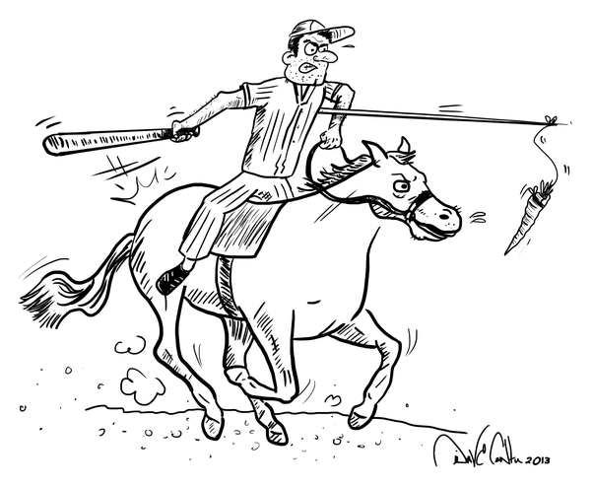
At the end…
when adopting OS policy one have to also think about implementation of rewards (‘carrot’) and incentives (‘stick’) mechanisms
taking into a cosideration the national context
importance of monitoring mechanisms od adopted OS policies
Source: https://www.quora.com/What-is-carrot-and-stick-policy

Slide 21
Thank you!
NI4OS_eu NI4OS ni4os.eu
Bojan Macan, Ph. D., EOSC promotor
Ruđer Bošković Institute, Centre for Scientific Information, Zagreb, CROATIA
e-mail: bojan.macan@irb.hr

